Slide 1
Commitment to the Botulinum Toxin Class
Presented to:
Presented by:
Date:

Slide 2
BOTOX® (onabotulinumtoxinA) & BOTOX® Cosmetic (onabotulinumtoxinA) Important Safety Information
IMPORTANT SAFETY INFORMATION, INCLUDING BOXED WARNING
WARNING: DISTANT SPREAD OF TOXIN EFFECT
Postmarketing reports indicate that the effects of BOTOX® and all botulinum toxin products may spread from the area of injection to produce symptoms consistent with botulinum toxin effects. These may include asthenia, generalized muscle weakness, diplopia, ptosis, dysphagia, dysphonia, dysarthria, urinary incontinence, and breathing difficulties. These symptoms have been reported hours to weeks after injection. Swallowing and breathing difficulties can be life threatening, and there have been reports of death. The risk of symptoms is probably greatest in children treated for spasticity, but symptoms can also occur in adults treated for spasticity and other conditions, particularly in those patients who have an underlying condition that would predispose them to these symptoms. In unapproved uses, including spasticity in children, and in approved indications, cases of spread of effect have been reported at doses comparable to those used to treat cervical dystonia and at lower doses.
Please see additional Important Safety Information on the next slide.

Slide 3
BOTOX® (onabotulinumtoxinA) & BOTOX® Cosmetic (onabotulinumtoxinA) Important Safety Information
Indications
Bladder Dysfunction:
Overactive Bladder
BOTOX® for injection is indicated for the treatment of overactive bladder with symptoms of urge urinary incontinence, urgency, and frequency, in adults who have an inadequate response to or are intolerant of an anticholinergic medication.
Detrusor Overactivity Associated With a Neurologic Condition
BOTOX® for injection is indicated for the treatment of urinary incontinence due to detrusor overactivity associated with a neurologic condition (eg, SCI, MS) in adults who have an inadequate response to or are intolerant of an anticholinergic medication.
Chronic Migraine
BOTOX® for injection is indicated for the prophylaxis of headaches in adult patients with chronic migraine (≥ 15 days per month with headache lasting 4 hours a day or longer).
Important Limitations
Safety and effectiveness have not been established for the prophylaxis of episodic migraine (14 headache days or fewer per month) in 7 placebo-controlled studies.
Upper Limb Spasticity
BOTOX® for injection is indicated for the treatment of upper limb spasticity in adult patients, to decrease the severity of increased muscle tone in elbow flexors (biceps), wrist flexors (flexor carpi radialis and flexor carpi ulnaris), and finger flexors (flexor digitorum profundus and flexor digitorum sublimis).
Important Limitations
Safety and effectiveness of BOTOX® have not been established for the treatment of other upper limb muscle groups, or for the treatment of lower limb spasticity. Safety and effectiveness of BOTOX® have not been established for the treatment of spasticity in pediatric patients under age 18 years. BOTOX® has not been shown to improve upper extremity functional abilities, or range of motion at a joint affected by a fixed contracture. Treatment with BOTOX® is not intended to substitute for usual standard of care rehabilitation regimens.
Please see additional Indications and Important Safety Information on the next slide.

Slide 4
BOTOX® (onabotulinumtoxinA) & BOTOX® Cosmetic (onabotulinumtoxinA) Important Safety Information (continued)
Cervical Dystonia
BOTOX® is indicated for the treatment of adults with cervical dystonia to reduce the severity of abnormal head position and neck pain associated with cervical dystonia.
Blepharospasm and Strabismus
BOTOX® is indicated for the treatment of strabismus and blepharospasm associated with dystonia, including benign essential blepharospasm or VII nerve disorders in patients 12 years of age and above.
Primary Axillary Hyperhidrosis
BOTOX® is indicated for the treatment of severe primary axillary hyperhidrosis that is inadequately managed with topical agents. Important Limitations
The safety and effectiveness of BOTOX® for hyperhidrosis in other body areas have not been established. Weakness of hand muscles and blepharoptosis may occur in patients who receive BOTOX® for palmar hyperhidrosis and facial hyperhidrosis, respectively. Patients should be evaluated for potential causes of secondary hyperhidrosis (eg, hyperthyroidism) to avoid symptomatic treatment of hyperhidrosis without the diagnosis and/or treatment of the underlying disease. Safety and effectiveness of BOTOX® have not been established for the treatment of axillary hyperhidrosis in pediatric patients under age 18.
Glabellar Lines
BOTOX® Cosmetic is indicated for the temporary improvement in the appearance of moderate to severe glabellar lines associated with corrugator and/or procerus muscle activity in patients 18 to 65 years of age. Lateral Canthal Lines BOTOX® Cosmetic is indicated for the temporary improvement in the appearance of moderate to severe lateral canthal lines associated with orbicularis oculi activity in adult patients.
Please see additional Important Safety Information on the next slide.

Slide 5
BOTOX® (onabotulinumtoxinA) & BOTOX® Cosmetic (onabotulinumtoxinA) Important Safety Information (continued)
IMPORTANT SAFETY INFORMATION (cont.)
CONTRAINDICATIONS
BOTOX® and BOTOX® Cosmetic are contraindicated in the presence of infection at the proposed injection site(s) and in individuals with known hypersensitivity to any botulinum toxin preparation or to any of the components in the formulation. Intradetrusor injection of BOTOX® is contraindicated in patients with overactive bladder or detrusor overactivity associated with a neurologic condition who have a urinary tract infection (UTI). Intradetrusor injection of BOTOX® is also contraindicated in patients with urinary retention and in patients with post-void residual (PVR) urine volume >200 mL, who are not routinely performing clean intermittent self-catheterization (CIC). WARNINGS AND PRECAUTIONS
Lack of Interchangeability Between Botulinum Toxin Products
The potency Units of BOTOX® and BOTOX® Cosmetic are specific to the preparation and assay method utilized. They are not interchangeable with other preparations of botulinum toxin products and, therefore, units of biological activity of BOTOX® and BOTOX® Cosmetic cannot be compared to nor converted into units of any other botulinum toxin products assessed with any other specific assay method. Spread of Toxin Effect
See Boxed Warning.
No definitive serious adverse event reports of distant spread of toxin effect associated with dermatologic use of BOTOX®/BOTOX® Cosmetic at the labeled dose of 20 Units (for glabellar lines) or at the labeled dose of 100 Units (for severe primary axillary hyperhidrosis) have been reported. No definitive serious adverse event reports of distant spread of toxin effect associated with BOTOX® for blepharospasm at the recommended dose (30 Units and below), strabismus, or chronic migraine at the labeled doses have been reported.
Please see additional Important Safety Information on the next slide.

Slide 6
BOTOX® (onabotulinumtoxinA) & BOTOX® Cosmetic (onabotulinumtoxinA) Important Safety Information (continued)
Injections In or Near Vulnerable Anatomic Structures
Care should be taken when injecting in or near vulnerable anatomic structures. Serious adverse events including fatal outcomes have been reported in patients who had received BOTOX® injected directly into salivary glands, the oro-lingual-pharyngeal region, esophagus and stomach. Some patients had pre-existing dysphagia or significant debility. (Safety and effectiveness have not been established for indications pertaining to these injection sites.) Pneumothorax associated with injection procedure has been reported following the administration of BOTOX® near the thorax. Caution is warranted when injecting in proximity to the lung, particularly the apices. Hypersensitivity Reactions
Serious and/or immediate hypersensitivity reactions have been reported. These reactions include anaphylaxis, serum sickness, urticaria, soft-tissue edema, and dyspnea. If such a reaction occurs, further injection of BOTOX® or BOTOX® Cosmetic should be discontinued and appropriate medical therapy immediately instituted. One fatal case of anaphylaxis has been reported in which lidocaine was used as the diluent, and consequently the causal agent cannot be reliably determined. Dysphagia and Breathing Difficulties in Treatment of Cervical Dystonia
Treatment with BOTOX® and other botulinum toxin products can result in swallowing or breathing difficulties. Patients with pre-existing swallowing or breathing difficulties may be more susceptible to these complications. When distant effects occur, additional respiratory muscles may be involved (see Boxed Warning). Pre-Existing Neuromuscular Disorders
Individuals with peripheral motor neuropathic diseases, amyotrophic lateral sclerosis, or neuromuscular junctional disorders (eg, myasthenia gravis or Lambert-Eaton syndrome) should be monitored particularly closely when given botulinum toxin. Patients with neuromuscular disorders may be at increased risk of clinically significant effects including severe dysphagia and respiratory compromise from therapeutic doses of BOTOX®.
Please see additional Important Safety Information on the next slide.

Slide 7
BOTOX® (onabotulinumtoxinA) & BOTOX® Cosmetic (onabotulinumtoxinA) Important Safety Information (continued)
Pulmonary Effects of BOTOX® in Patients With Compromised Respiratory Status Treated for Spasticity or for Detrusor Overactivity Associated With a Neurologic Condition
Patients with compromised respiratory status treated with BOTOX® for upper limb spasticity or detrusor overactivity associated with a neurologic condition should be monitored closely. Corneal Exposure and Ulceration in Patients Treated With BOTOX® for Blepharospasm
Reduced blinking from BOTOX® injection of the orbicularis muscle can lead to corneal exposure, persistent epithelial defect, and corneal ulceration, especially in patients with VII nerve disorders. Retrobulbar Hemorrhages in Patients Treated With BOTOX® for Strabismus
During the administration of BOTOX® for the treatment of strabismus, retrobulbar hemorrhages sufficient to compromise retinal circulation have occurred. It is recommended that appropriate instruments to decompress the orbit be accessible. Bronchitis and Upper Respiratory Tract Infections in Patients Treated for Spasticity
Bronchitis was reported more frequently as an adverse reaction in patients treated for upper limb spasticity with BOTOX® (3% at 251-360 Units total dose) compared to placebo (1%). In patients with reduced lung function treated
for upper limb spasticity, upper respiratory tract infections were also reported more frequently as adverse reactions in patients treated with BOTOX® (11% at 360 Units total dose; 8% at 240 Units total dose) compared to placebo (6%).
Autonomic Dysreflexia in Patients Treated for Detrusor Overactivity Associated With a Neurologic Condition
Autonomic dysreflexia associated with intradetrusor injections of BOTOX® could occur in patients treated for detrusor overactivity associated with a neurologic condition and may require prompt medical therapy. In clinical trials, the incidence of autonomic dysreflexia was greater in patients treated with BOTOX® 200 Units compared with placebo (1.5% versus 0.4%, respectively).
Please see additional Important Safety Information on the next slide.

Slide 8
BOTOX® (onabotulinumtoxinA) & BOTOX® Cosmetic (onabotulinumtoxinA) Important Safety Information (continued)
Urinary Tract Infections in Patients with Overactive Bladder
BOTOX® increases the incidence of urinary tract infection. Clinical trials for overactive bladder excluded patients with more than 2 UTIs in the past 6 months and those taking antibiotics chronically due to recurrent UTIs. Use of BOTOX® for the treatment of overactive bladder in such patients and in patients with multiple recurrent UTIs during treatment should only be considered when the benefit is likely to outweigh the potential risk. Urinary Retention in Patients Treated for Bladder Dysfunction
Due to the risk of urinary retention, treat only patients who are willing and able to initiate catheterization post-treatment, if required, for urinary retention.
In patients who are not catheterizing, post-void residual (PVR) urine volume should be assessed within 2 weeks post-treatment and periodically as medically appropriate up to 12 weeks, particularly in patients with multiple sclerosis or diabetes mellitus. Depending on patient symptoms, institute catheterization if PVR urine volume exceeds 200 mL and continue until PVR falls below 200 mL. Instruct patients to contact their physician if they experience difficulty in voiding as catheterization may be required. Overactive Bladder
In clinical trials, 6.5% of patients (36/552) initiated clean intermittent catheterization for urinary retention following treatment with BOTOX® 100 Units as compared to 0.4% of patients (2/542) treated with placebo. The median duration of catheterization for patients treated with BOTOX® 100 Units was 63 days (minimum 1 day to maximum 214 days) as compared to a median duration 11 days (minimum 3 days to maximum 18 days) for patients receiving placebo. Patients with diabetes mellitus treated with BOTOX® were more likely to develop urinary retention than non-diabetics. In clinical trials, 12.3% of patients (10/81) with diabetes developed urinary retention following treatment with BOTOX® 100 Units vs. 0% patients (0/69) treated with placebo. In patients without diabetes, 6.3% of patients (33/526) developed urinary retention following treatment with BOTOX® 100 Units vs. 0.6% of patients (3/516) treated with placebo.
Please see additional Important Safety Information on the next slide.

Slide 9
BOTOX® (onabotulinumtoxinA) & BOTOX® Cosmetic (onabotulinumtoxinA) Important Safety Information (continued)
Detrusor Overactivity Associated With a Neurologic Condition
In clinical trials, 30.6% of patients (33/108) who were not using clean intermittent catheterization (CIC) prior to injection, required catheterization for urinary retention following treatment with BOTOX® 200 Units as compared to 6.7% of patients (7/104) treated with placebo. The median duration of post-injection catheterization for these patients treated with BOTOX® 200 Units (n=33) was 289 days (minimum 1 day to maximum 530 days) as compared to a median duration 358 days (minimum 2 days to maximum 379 days) for patients receiving placebo (n=7). Among patients not using CIC at baseline, those with MS were more likely to require CIC post-injection than those with SCI.
Human Albumin and Transmission of Viral Diseases
This product contains albumin, a derivative of human blood. Based on effective donor screening and product manufacturing processes, it carries an extremely remote risk for transmission of viral diseases. A theoretical risk for transmission of Creutzfeldt-Jakob disease (CJD) is also considered extremely remote. No cases of transmission of viral diseases or CJD have ever been reported for albumin.
Pre-existing Conditions at the Injection Site
Caution should be used when BOTOX® Cosmetic treatment is used in the presence of inflammation at the proposed injection site(s) or when excessive weakness or atrophy is present in the target muscle(s).
ADVERSE REACTIONS
The following adverse reactions to BOTOX® for injection are discussed in greater detail in the following sections: Spread of Toxin Effect (see Boxed Warning); Hypersensitivity Reactions (see Contraindications and Warnings and Precautions); Dysphagia and Breathing Difficulties in Treatment of Cervical Dystonia (see Warnings and Precautions); Bronchitis and Upper Respiratory Tract Infections in Patients Treated for Spasticity (see Warnings and Precautions) and Urinary Retention in Patients treated for Bladder Dysfunction (see Warnings and Precautions).
Please see additional Important Safety Information on the next slide.

Slide 10
BOTOX® (onabotulinumtoxinA) & BOTOX® Cosmetic (onabotulinumtoxinA) Important Safety Information (continued)
ADVERSE REACTIONS (cont.) Overactive Bladder
The most frequently reported adverse reactions for overactive bladder occurring within 12 weeks of injection include urinary tract infection (BOTOX® 18%, placebo 6%), dysuria (BOTOX® 9%, placebo 7%), urinary retention (BOTOX® 6%, placebo 0%), bacteriuria (BOTOX® 4%, placebo 2%), and residual urine volume (BOTOX® 3%, placebo 0%).
A higher incidence of urinary tract infection was observed in patients with diabetes mellitus treated with BOTOX® 100 Units and placebo than non-diabetics.
The incidence of UTI increased in patients who experienced a maximum post-void residual (PVR) urine volume ≥200 mL following BOTOX® injection compared to those with a maximum PVR <200 mL following BOTOX® injection, 44% versus 23%, respectively. Detrusor Overactivity associated with a Neurologic Condition
The most frequently reported adverse reactions within 12 weeks of BOTOX® injection for detrusor overactivity associated with a neurologic condition include urinary tract infection (BOTOX® 24%, placebo 17%), urinary retention (BOTOX® 17%, placebo 3%), hematuria (BOTOX® 4%, placebo 3%).
The following adverse event rates were reported at any time following initial injection and prior to reinjection or study exit (median duration of 44 weeks of exposure): urinary tract infections (49%), urinary retention (17%), constipation (4%), muscular weakness (4%), dysuria (4%), fall (3%), gait disturbance (3%), and muscle spasm (2%). Chronic Migraine
The most frequently reported adverse reactions following injection of BOTOX® for chronic migraine include neck pain (9%), headache (5%), eyelid ptosis (4%), migraine (4%), muscular weakness (4%), musculoskeletal stiffness (4%), bronchitis (3%), injection-site pain (3%), musculoskeletal pain (3%), myalgia (3%), facial paresis (2%), hypertension (2%), and muscle spasms (2%). Upper Limb Spasticity
The most frequently reported adverse reactions following injection of BOTOX® for upper limb spasticity include pain in extremity, muscle weakness, fatigue, nausea, and bronchitis.
Please see additional Important Safety Information on the next slide.

Slide 11
BOTOX® (onabotulinumtoxinA) & BOTOX® Cosmetic (onabotulinumtoxinA) Important Safety Information (continued)
ADVERSE REACTIONS (cont.)
Cervical Dystonia
The most frequently reported adverse reactions following injection of BOTOX® for cervical dystonia include dysphagia (19%), upper respiratory infection (12%), neck pain (11%), and headache (11%).
Blepharospasm
The most frequently reported adverse reactions following injection of BOTOX® for blepharospasm include ptosis (21%), superficial punctate keratitis (6%), and eye dryness (6%).
Strabismus
The most frequently reported adverse events following injection of BOTOX® for strabismus include ptosis (15.7%) and vertical deviation (16.9%). Primary Axillary Hyperhidrosis
The most frequently reported adverse events (3%-10% of adult patients) following injection of BOTOX® for severe primary axillary hyperhidrosis include injection-site pain and hemorrhage, non-axillary sweating, infection, pharyngitis, flu syndrome, headache, fever, neck or back pain, pruritus, and anxiety. Glabellar Lines The most frequently reported adverse events following injection of BOTOX® Cosmetic was eyelid ptosis (3%). Lateral Canthal Lines The most frequently reported adverse event following injection of BOTOX® Cosmetic for lateral canthal lines was eyelid edema (1%).
Please see additional Important Safety Information on the next slide.

Slide 12
BOTOX® (onabotulinumtoxinA) & BOTOX® Cosmetic (onabotulinumtoxinA) Important Safety Information (continued)
Post Marketing Experience
There have been spontaneous reports of death, sometimes associated with dysphagia, pneumonia, and/or other significant debility or anaphylaxis, after treatment with botulinum toxin. There have also been reports of adverse events involving the cardiovascular system, including arrhythmia and myocardial infarction, some with fatal outcomes. Some of these patients had risk factors including cardiovascular disease. The exact relationship of these events to the botulinum toxin injection has not been established. DRUG INTERACTIONS
Co-administration of BOTOX® or BOTOX® Cosmetic and aminoglycosides or other agents interfering with neuromuscular transmission (e.g. curare-like compounds) should only be performed with caution as the effect of the toxin may be potentiated. Use of anticholinergic drugs after administration of BOTOX® or BOTOX® Cosmetic may potentiate systemic anticholinergic effects. The effect of administering different botulinum neurotoxin products at the same time or within several months of each other is unknown. Excessive neuromuscular weakness may be exacerbated by administration of another botulinum toxin prior to the resolution of the effects of a previously administered botulinum toxin. Excessive weakness may also be exaggerated by administration of a muscle relaxant before or after administration of BOTOX® or BOTOX® Cosmetic. USE IN SPECIFIC POPULATIONS
BOTOX® and BOTOX® Cosmetic are not recommended for use in pregnant women. BOTOX® Cosmetic is not recommended for use in children. It is not known whether BOTOX® Cosmetic is excreted in human milk. Caution should be exercised when BOTOX® Cosmetic is administered to a nursing woman.
Please see the full BOTOX® and BOTOX® Cosmetic Prescribing Information, including Boxed Warning and Medication Guide available at this presentation.

Slide 13
Allergan Leadership in Neurotoxin Therapy
Allergan is committed to neurotoxin research, training, support and education
Strong focus on BOTOX® (onabotulinumtoxinA) R&D¹
BOTOX® is the only botulinum toxin on the market with 8 therapeutic indications approved by the FDA
Allergan has conducted more than 1,000 peer-to-peer training programs for almost 6,000 healthcare providers in 2014
Allergan has a dedicated force of highly-trained Neuroscience Specialists focused exclusively on providing educational tools and resources to providers about the medical uses of BOTOX®
Allergan works with many professional associations and patient support groups committed to the advancement of medicine to help improve patient outcomes
Please see BOTOX® and BOTOX® Cosmetic Important Safety Information included in this presentation.
References: 1. Data on file. Allergan, Inc. 2008.
Notes:
13

Slide 14
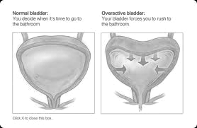
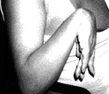

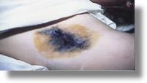
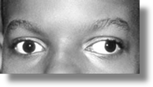
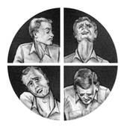
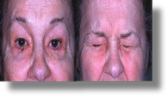
History of BOTOX® and BOTOX® Cosmetic (onabotulinumtoxinA)
NEUROLOGIC DETRUSOR OVERACTIVITY
OVERACTIVE BLADDER
UPPER LIMB
SPASTICITY
CHRONIC
MIGRAINE
SEVERE PRIMARY AXILLARY HYPERHIDROSIS
2013
CERVICAL DYSTONIA
2011
STRABISMUS
BOTOX®
approved
(treatment of urinary incontinence due to detrusor overactivity associated with a neurologic condition [e.g., SCI, MS] in adults who have an inadequate response to or are intolerant of an anticholinergic medication)
2010
2009
BLEPHAROSPASM
2004
2002
BOTOX®
approved
(treatment of upper limb spasticity in adult patients to decrease the severity of increased muscle tone in elbow, wrist and finger flexors) muscle tone in elbow, wrist and finger flexors
BOTOX®
approved
(prophylaxis of headaches in adults with chronic migraine [>15 days per month with headache lasting 4 hrs. and/or longer])
2000
BOTOX®
approved
(severe primary axillary hyperhidrosis inadequately managed by topical agents)
1989
BOTOX®
approved
for the treatment of overactive bladder with symptoms of urge urinary incontinence, urgency, and frequency, in adults who have an inadequate response to or are intolerant of an anticholinergic medication BOTOX® Cosmetic approved
(moderate to severe lateral canthal lines)
BOTOX®
approved
(cervical dystonia)
BOTOX® Cosmetic approved (moderate to severe glabellar lines)
BOTOX® approved (strabismus, blepharospasm)
Xeomin® (incobotulinumtoxinA)
Merz Pharmaceuticals
(glabellar lines)
Dysport® (abobotulinumtoxinA)
Ipsen/Medicis
(cervical dystonia / glabellar lines)
Xeomin® (incobotulinumtoxinA)
Merz Pharmaceuticals
(cervical dystonia / blepharospasm)
Myobloc® (rimabotulinumtoxinB)
Solstice Neurosciences
(cervical dystonia)
Please see BOTOX® and BOTOX® Cosmetic Important Safety Information included in this presentation.
References: 1. BOTOX® [prescribing information]. Irvine, CA: Allergan, Inc.; February 2014. 2. Dysport [prescribing information]. Basking Ridge, NJ: Ipsen Biopharm Ltd.; March 2012. 3. Myobloc [prescribing information]. Malvern, PA: Solstice Neurosciences, Inc.; May 2010. 4. Xeomin [prescribing information]. Greensboro, NC: Merz Pharmaceuticals, LLC.; April 2014.

Slide 15

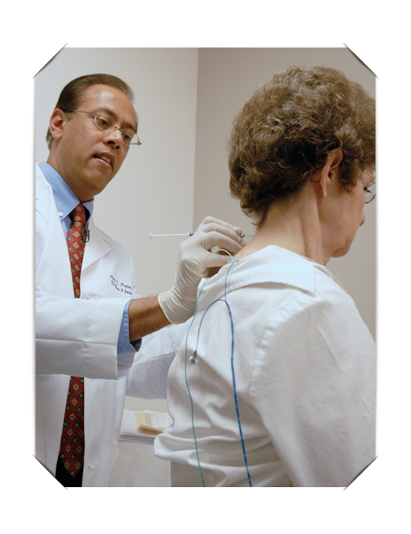
Neurosciences Physician Training (2014)¹ Chronic Migraine – Upper Limb Spasticity – Cervical Dystonia
LOCAL LIVE PROGRAM
PRECEPTORSHIP PROGRAM
PROCTORSHIP PROGRAM
Objective: Educate and increase comfort for both new and low-level injectors
Meeting Format: Small-group training sessions with audience size of 3-6 HCPs
Summary: Combined presentation on diagnosis and treatment with hands-on workshop focusing on reconstitution and injection training on an anatomical simulator
Objective: Increase comfort among low to mid-level injectors
Meeting Format: Peer-to-peer 1:1 observational training conducted by expert faculty who performs treatment on live patients
Summary: Half-day session in faculty office. Faculty instructs trainee on patient identification, safety, and dosing before performing injections on 3 to 6 patients while trainee observes
Objective: Increase comfort among low to mid-level injectors
Meeting Format: Peer-to-peer 1:1 training with expert faculty observing and counseling trainees treating live patients
Summary: Half-day session in trainee office. Faculty observes patient interactions and instructs trainee on patient identification, safety, and dosing before counseling trainee injecting 3 to 6 patients
Please see BOTOX® and BOTOX® Cosmetic Important Safety Information included in this presentation.
Reference: 1. Data on file, Allergan, Inc.

Slide 16
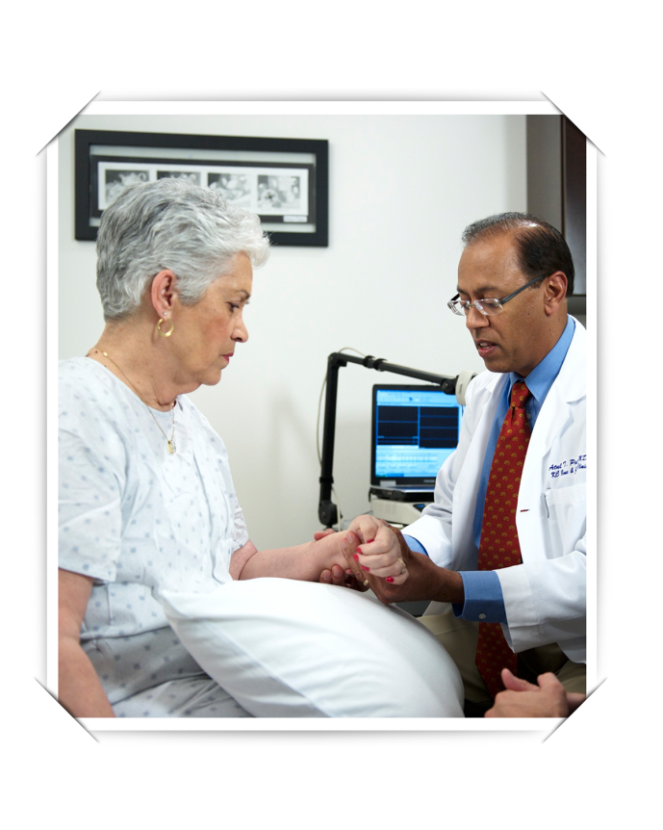
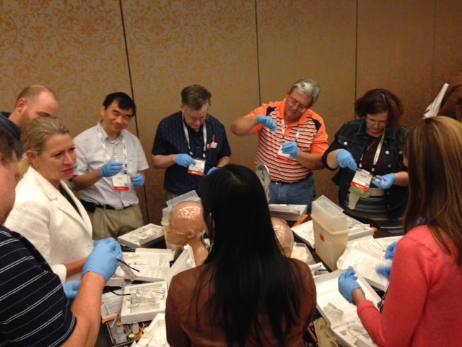
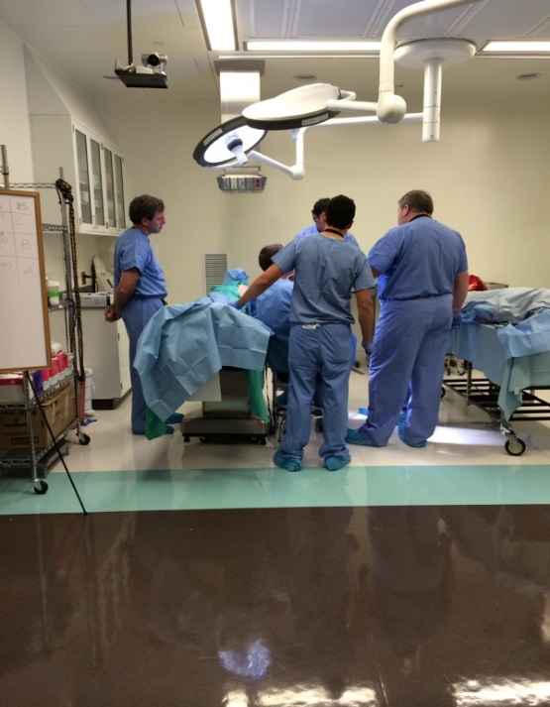
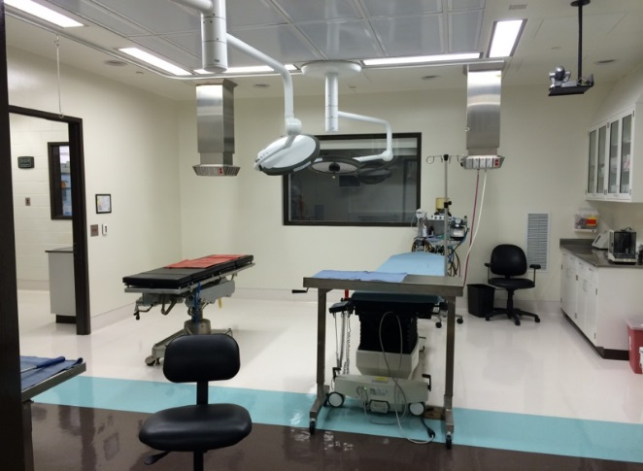
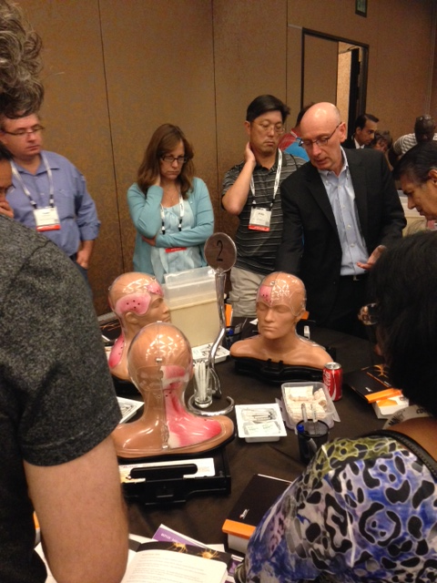
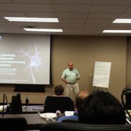
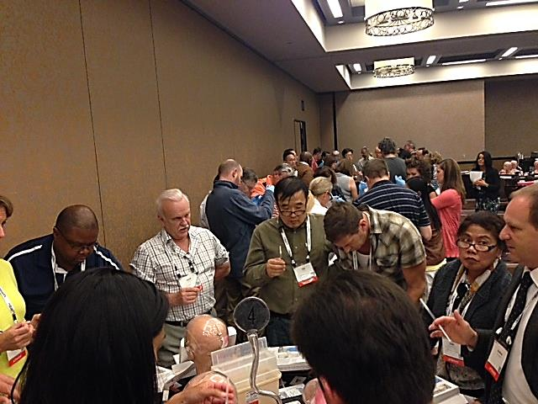
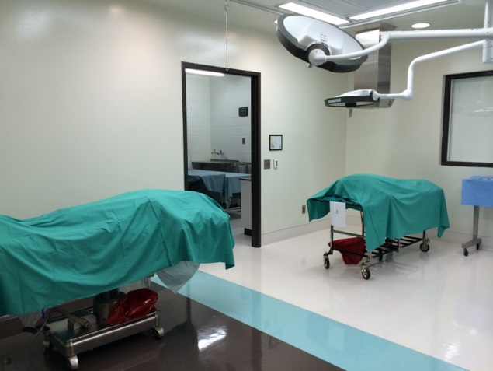
Neurosciences Physician Training 2014¹ (cont’d.) Chronic Migraine – Upper Limb Spasticity – Cervical Dystonia
BOTOX® LIVE PROGRAMS
RIT (BREAKING BARRIERS)
RITE CADAVER COURSES
Objective: Increase comfort among current injectors
Meeting Format: Small-group training sessions with audience size of 5-10 injector trainees
Live patient injections demonstrated after clinical presentation on disease state and clinical efficacy
Summary: Expert clinical discussion, multiple LIVE patient injections, injection guidance technology demonstration
Objective: Increase comfort among injectors with BOTOX® experience
Meeting Format/Target Attendees: Regional program held in conjunction with a congress
Summary: 30-45 minute didactic presentation on disease state and clinical efficacy with live patient injection demonstrations
Objective and Meeting Format: 6-hour program covering disease state and clinical efficacy for CD and ULS. The course runs twice on back-to-back days, to accommodate 2 different groups of physicians in the training. The first half of the day’s program is approx. 2-3 hours of ULS and CD didactic presentation and discussion in a classroom setting. The second half of the program is approx. 2-3 hours in the cadaver lab focusing on assessment of functional anatomy, muscle localization, and injection training. The program sometimes concludes with a live injection of a ULS or CD patient, back in the didactic classroom
Please see BOTOX® and BOTOX® Cosmetic Important Safety Information included in this presentation.
Reference: 1. Data on file, Allergan, Inc.

Slide 17
Neurosciences Physician Training 2014¹ (cont’d.) Chronic Migraine – Upper Limb Spasticity – Cervical Dystonia
Physician Education
As of 12/01/14
Cumulative 2014
Programs
Attendees
Neuro Rehab Training
CD Local Live
36
251
CD Preceptorship
53
161
CD Proctorship
8
69
ULS BOTOX® Live
16
80
ULS Local Live
132
1115
ULS Preceptorship
84
194
ULS Proctorship
18
48
ULS Take Action
36
575
ULS/CD BOTOX® Live
10
51
ULS/CD Preceptorship
44
155
ULS/CD Proctorship
17
99
RITE
8
112
TOTAL
462
2910
Chronic Migraine Training
CM Local Live
243
1678
CM Preceptorship
248
604
CM Proctorship
70
237
CM Take Action
22
303
CM Breaking Barriers
2
204
TOTAL
585
3026
Total Portfolio
All Conditions/All Programming
1047
5936
Please see BOTOX® and BOTOX® Cosmetic Important Safety Information included in this presentation.
Reference: 1. Data on file, Allergan, Inc.

Slide 18
Allergan – Leadership in Patient Support Groups¹
Chronic migraine
American Migraine and Headache Association (AHMA) – patient foundation of American Headache Society (AHS)
American Brain Foundation – patient foundation of American Academy of Neurology® (AAN)
National Headache Foundation (NHF)
American Chronic Pain Association (ACPA)
Miles for Migraines
HealthyWomen
Society for Women’s Health Research® (SWHR)
Combo: ULS and urology
United Spinal Association
Paralyzed Veterans of America
National Stroke Association® (NSA)
MS World®
National MS Society (NMSS)
Multiple Sclerosis Association of America™ (MSAA)
MS Foundation
Can Do™ MS
Cervical dystonia
Dystonia Medical Research Foundation (DMRF)
Benign Essential Blepharospasm Research Foundation (BEBRF)
Spasmodic Torticollis (ST)/Dystonia
National Spasmodic Torticollis Association (NSTA)
Urology specific
Urology Care Foundation
National Association for Continence (NAFC)
Simon Foundation for Continence
Women’s Health Foundation
Please see BOTOX® and BOTOX® Cosmetic Important Safety Information included in this presentation.
Reference: 1. Data on file, Allergan, Inc.
Notes:
18

Slide 19
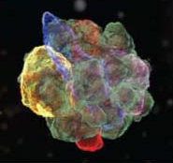
BOTOX® (onabotulinumtoxinA): A Complex Molecular Structure
BOTOX® neurotoxin consists of a 150 kD core neurotoxin (common to all toxins) surrounded by ≈ 750 kD accessory proteins for a total of ≈ 900 kD
Accessory proteins play an important role in BOTOX® neurotoxin stabilization
In nature, botulinum neurotoxin associates with complementary nontoxic accessory proteins to produce protein complexes^{1,2}
Botulinum neurotoxin type A accessory proteins have been demonstrated to stabilize the core neurotoxin against thermal and pH stress^{3,4}
BOTOX® accessory proteins are not expected to contribute to clinical immunogenicity
The science of botulinum toxin suggests that antibodies form in 2 categories⁵
Neutralizing antibodies develop against the core toxin and would be expected to interfere with its biologic activity⁵
Non-neutralizing antibodies can develop against accessory proteins but they are NOT expected to interfere with the core toxin’s biologic activity⁵
Please see BOTOX® and BOTOX® Cosmetic Important Safety Information included in this presentation.
References: 1. Inoue K, et al. Infect Immun. 1996;64(5):1589-1594. 2. Ohishi I, et al. Infect Immun. 1977;16(1):107-109. 3. Brandau DT, et al. Mol Pharm. 2007;4(4):571-582. 4. Kukreja RV, et al. Biochemistry. 2007;46(49):14316-14324. 5. Dressler D, et al. Eur J Neurol. 2006;13(suppl 1):11-15.

Slide 20
Differences Exist Between BoNT Products
Potency units of botulinum toxins are non-interchangeable¹
Units of one toxin cannot be compared nor converted to units of another toxin¹⁻⁵
Unit potency differences exist; the method utilized for performing the potency assay is specific to each manufacturer's botulinum toxin²⁻⁵
Differences are significant enough to result in FDA nomenclature change²⁻⁵
BOTOX® is onabotulinumtoxinA
Dysport® is abobotulinumtoxinA
Xeomin® is incobotulinumtoxinA
Myobloc® is rimabotulinumtoxinB
Please see BOTOX® and BOTOX® Cosmetic Important Safety Information included in this presentation.
References: 1. FDA/CDER. 2008. 2. BOTOX® [prescribing information]. Irvine, CA: Allergan, Inc.; February 2014. 3. Myobloc [prescribing information]. Malvern, PA: Solstice Neurosciences, Inc.; May 2010. 4. Dysport [prescribing information]. Basking Ridge, NJ: Ipsen Biopharm Ltd.; March 2012. 5. Xeomin [prescribing information]. Greensboro, NC: Merz Pharmaceuticals, LLC.; April 2014.
Notes:
20

Slide 21
Unit Potency Differences Create Non-Interchangeability Among Toxins
Familiar dose response
Units of neurotoxins and their dosing are not interchangeable
No dose ratios exist between any BoNT products
Warnings that clinical doses are not interchangeable are emphasized in BoNT product labels and multiple FDA communications¹⁻⁴
Noninferiority studies cannot be used to suggest a dose ratio
Please see BOTOX® and BOTOX® Cosmetic Important Safety Information included in this presentation.
References: 1. BOTOX® [prescribing information]. Irvine, CA: Allergan, Inc.; February 2014. 2. Myobloc [prescribing information]. Malvern, PA: Solstice Neurosciences, Inc.; May 2010. 3. Dysport [prescribing information]. Basking Ridge, NJ: Ipsen Biopharm Ltd.; March 2012. 4. Xeomin [prescribing information]. Greensboro, NC: Merz Pharmaceuticals, LLC.; April 2014.

Slide 22
Cervical Dystonia Market Share for BOTOX® (onabotulinumtoxinA) Patients Remains High and Majority of Doses Are Under 200 Units
Month ending…
È
Ç
Base: Treatment opportunities. Data is weighted based on the number of charts.
N/O/P/M: Significantly greater than indicated group at a 95% confidence level. /: Significantly different than previous month at a 95% confidence level. ¢: Small base size. March 15 – 22.
Reference: 1. Data on file. Allergan, Inc.
Please see BOTOX® and BOTOX® Cosmetic Important Safety Information included in this presentation.
Notes:
NOTE: IF USED, OPTIONAL SLIDES SHOULD BE INSERTED AFTER THIS SLIDE.

Slide 23
Commitment to the Botulinum Toxin Class: Upper Limb Spasticity Module
Presented to:
Presented by:
Date:

Slide 24
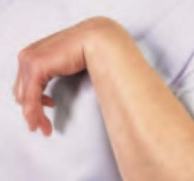
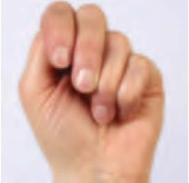
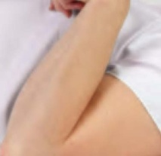
Upper Limb Spasticity: A Debilitating Condition
Upper limb spasticity is a condition in which certain muscles are continuously contracted
Since spastic muscles cannot relax, the contraction causes stiffness or tightness of the muscles and may interfere with movement
Upper limb spasticity affects approximately 1 million people in the US
Upper Limb Spasticity
The flexed wrist
Stiffness or deformity of limbs/extremities is the eighth most leading cause of disability in the U.S.¹
The clenched fist
The flexed elbow
Please see BOTOX® and BOTOX ® Cosmetic Important Safety Information including Boxed Warning included in this presentation.
Reference: 1. Centers for Disease Control and Prevention. MMWR Weekly. 2009;58(16):421-426.
Notes:
Reference:
1. Center for Disease Control and Prevention. Prevalence and Most Common Causes of Disability Among Adults – United States, 2005. MMWR Weekly. 2009;58(16):421-426.

Slide 25
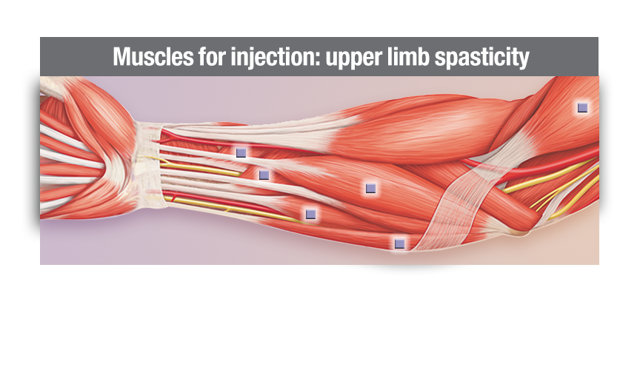
Location and Dosing: Upper Limb Spasticity¹
BOTOX® (onabotulinumtoxinA) is indicated for the treatment of upper limb spasticity in adult patients, to decrease the severity of increased muscle tone in elbow flexors (biceps), wrist flexors (flexor carpi radialis and flexor carpi ulnaris), and finger flexors (flexor digitorum profundus and flexor digitorum sublimis).
Important Limitations
Safety and effectiveness of BOTOX® have not been established for the treatment of other upper limb muscle groups, or for the treatment of lower limb spasticity. Safety and effectiveness of BOTOX® have not been established for the treatment of spasticity in pediatric patients under age 18 years. BOTOX® has not been shown to improve upper extremity functional abilities, or range of motion at a joint affected by a fixed contracture. Treatment with BOTOX® is not intended to substitute for usual standard of care rehabilitation regimens.
Please see BOTOX® and BOTOX ® Cosmetic Important Safety Information including Boxed Warning included in this presentation.
Reference: 1. BOTOX® [Prescribing Information]. Irvine, CA: Allergan, Inc.; February 2014.
Notes:
Reference:
1. BOTOX® [Prescribing Information]. Irvine, CA: Allergan, Inc.; February 2014.

Slide 26
Summary of BOTOX® (onabotulinumtoxinA) Study Design¹
The efficacy and safety of BOTOX® for the treatment of upper limb spasticity were evaluated in three randomized, multi-center, double-blind, placebo-controlled studies
Study 1 included 126 patients (64 BOTOX® and 62 placebo) with upper limb spasticity (Ashworth score of at least 3 for wrist flexor tone and at least 2 for finger flexor tone) who were at least 6 months post-stroke
BOTOX® (a total dose of 200 Units to 240 Units) and placebo were injected intramuscularly (IM) into the flexor digitorum profundus, flexor digitorum sublimis, flexor carpi radialis, flexor carpi ulnaris, and if necessary into the adductor pollicis and flexor pollicis longus
The primary efficacy variable was wrist flexors muscle tone at Week 6
Study 2 compared 3 doses of BOTOX® with placebo and included 91 patients [BOTOX® 360 Units (N=21), BOTOX® 180 Units (N=23), BOTOX® 90 Units (N=21), and placebo (N=26)] with upper limb spasticity (expanded Ashworth score of at least 2 for elbow flexor tone and at least 3 for wrist flexor tone) who were at least 6 weeks post-stroke
BOTOX® and placebo were injected with EMG guidance into the flexor digitorum profundus, flexor digitorum sublimis, flexor carpi radialis, flexor carpi ulnaris, and biceps brachii
The primary efficacy variable was the wrist flexor tone at Week 6
Study 3 compared 3 doses of BOTOX® with placebo and enrolled 88 patients [BOTOX® 360 Units (N=23), BOTOX® 180 Units (N=23), BOTOX® 90 Units (N=23), and placebo (N=19)] with upper limb spasticity (expanded Ashworth score of at least 2 for elbow flexor tone and at least 3 for wrist flexor tone and/or finger flexor tone) who were at least 6 weeks post-stroke
BOTOX® and placebo were injected with EMG guidance into the flexor digitorum profundus, flexor digitorum sublimis, flexor carpi radialis, flexor carpi ulnaris, and biceps brachii
The primary efficacy variable was wrist and elbow flexor tone
Please see BOTOX® and BOTOX ® Cosmetic Important Safety Information including Boxed Warning included in this presentation.
Reference: 1. BOTOX® [Prescribing Information]. Irvine, CA: Allergan, Inc.; February 2014.
Notes:
Reference:
BOTOX® [Prescribing Information]. Irvine, CA: Allergan, Inc.; February 2014.

Slide 27
Incidence of Adverse Events in Doses Up to 360 Units
Adverse reactions reported by ≥ 2% of BOTOX® treated patients and more frequent than in placebo-treated patients in adult spasticity double-blind, placebo-controlled clinical trials¹
Adverse Reaction by System Organ Class | Placebo (n = 182) | BOTOX® ˂ 150 Units (n = 54) | BOTOX® 150 to 250 Units (n = 188) | BOTOX® 251 to 360 Units (n = 115)
Gastrointestinal disorder Nausea | 1 (1%) | 1 (2%) | 3 (2%) | 3 (3%)
General disorders and administration site conditions Fatigue | 0 | 1 (2%) | 4 (2%) | 4 (3%)
Infections and infestations Bronchitis | 2 (1%) | 0 | 4 (2%) | 4 (3%)
Musculoskeletal and connective-tissue disorders Pain in extremity Muscular weakness | 8 (4%) 2 (1%) | 5 (9%) 1 (2%) | 10 (5%) 7 (4%) | 7 (6%) 0
0.3% (n = 362) rate of discontinuation due to adverse events vs 0.5% (n = 182) for placebo²
Please see BOTOX® and BOTOX ® Cosmetic Important Safety Information including Boxed Warning included in this presentation.
Reference: 1. BOTOX® [Prescribing Information]. Irvine, CA: Allergan, Inc.; February 2014. 2. Data on file, Allergan, Inc. BOTOX® Summary of Clinical Safety (LLS).
Notes:
References:
1. BOTOX® [Prescribing Information]. Irvine, CA: Allergan, Inc.; February 2014.
2. Data on file, Allergan, Inc. BOTOX® Summary of Clinical Safety (LLS).

Slide 28
Efficacy and Safety of BOTOX® (onabotulinumtoxinA) for the Treatment of Upper Limb Spasticity Evaluated in Three Randomized, Multicenter, Double-blind, Placebo-controlled Studies¹
Study | Number of Patients | Time Since Stroke | Condition Parameters | BOTOX® (onabotulinumtoxinA) Dosage | Double-blind Period
Study 1 | N = 126 BOTOX® (n = 64) Placebo (n = 62) | ≥ 6 months | Ashworth Scale score of at least 3 for wrist flexor tone and at least 2 for finger flexor tone | 200-240 U | 12 weeks
Study 2 | N = 91 BOTOX® (n = 65) Placebo (n = 26) | ≥ 6 weeks | Expanded Ashworth Scale score of at least 2 for elbow flexor tone and at least 3 for wrist flexor tone | 360 U (n = 21) 180 U (n = 23) 90 U (n = 21) | 24 weeks
Study 3 | N = 88 BOTOX® (n = 69) Placebo (n = 19) | ≥ 6 weeks | Expanded Ashworth Scale score of at least 2 for elbow flexor tone and at least 3 for wrist flexor tone and/or finger flexor tone | 360 U (n = 23) 180 U (n = 23) 90 U (n = 23) | 12 weeks
Please see BOTOX® and BOTOX ® Cosmetic Important Safety Information including Boxed Warning included in this presentation.
Reference: 1. BOTOX® [Prescribing Information]. Irvine, CA: Allergan, Inc.; February 2014.
Notes:
Reference:
1. BOTOX® [Prescribing Information]. Irvine, CA: Allergan, Inc.; February 2014.

Slide 29
Thank you
Please see BOTOX® full prescribing information, including Boxed Warning and Medication Guide, available at this presentation.
© 2014 Allergan, Inc. All Rights Reserved.
® marks owned by Allergan, Inc. www.allergan.com APC03AB14

Slide 30
Commitment to the Botulinum Toxin Class: OAB Module
Presented to:
Presented by:
Date:

Slide 31
Diagnosis of Overactive Bladder (OAB) is Based Upon the Presence of Hallmark Symptoms
Defined as urinary urgency, with or without urge urinary incontinence, usually with frequency in the absence of UTI or other obvious pathology¹
The bladder essentially has an inability to appropriately store urine which results in various symptoms^{1,2}
Urgency
Urge urinary incontinence
Frequency
OAB symptoms do not have a neurologic cause¹
OAB and neurogenic detrusor overactivity (NDO) are not the same condition
The diagnosis differs between OAB and NDO: OAB is a clinical, symptom-based diagnosis¹ whereas NDO requires urodynamic diagnosis²
Please see BOTOX® and BOTOX ® Cosmetic Important Safety Information including Boxed Warning included in this presentation.
References: 1. Gormley AE et al AUA. 2013. Available at: http://www.auanet.org/common/pdf/education/clinical-guidance/ Overactive-Bladder.pdf. Accessed December 18, 2013. 2. Abrams P, Cardozo L, Fall M. et al. The Standardisation of Terminology of Lower Urinary Tract Function: Report from the Standardisation Sub-committee of the International Continence Society. Neurourology and Urodynamics. 2002;21:167-178.
Notes:
31

Slide 32
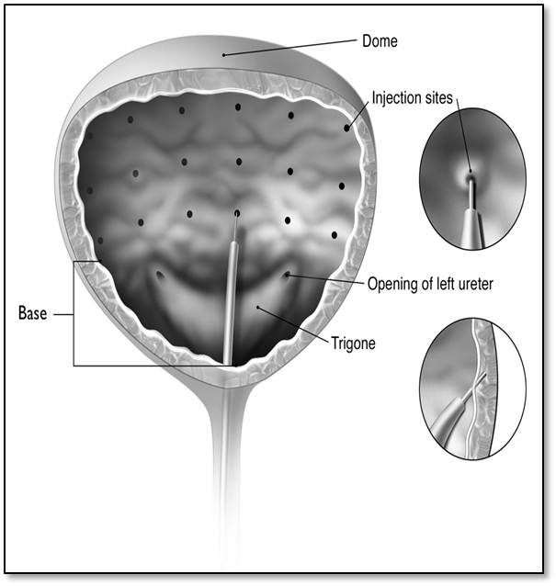
Administration of BOTOX® (onabotulinumtoxinA)
32
BOTOX® for injection is the only neurotoxin indicated for the treatment of overactive bladder with symptoms of urge urinary incontinence, urgency, and frequency, in adults who have an inadequate response to or are intolerant of an anticholinergic medication¹
Using a flexible or rigid cystoscope, physicians administer 20, 0.5 mL injections (1 cm apart) of BOTOX® 100 Units¹
Patients must not have a UTI at the time of treatment. Prophylactic antibiotics, except aminoglycosides, should be administered 1-3 days pre-treatment, on the treatment day, and 1-3 days post-treatment¹
Patients should discontinue antiplatelet therapy at least 3 days before the injection procedure¹
Please see BOTOX® and BOTOX ® Cosmetic Important Safety Information including Boxed Warning
included in this presentation.
Reference: 1. BOTOX® [Prescribing Information]. Irvine, CA: Allergan, Inc.; February, 2014.

Slide 33
Summary of BOTOX® (onabotulinumtoxinA) Study Design
Two double-blind, placebo-controlled, randomized, multi-center, 24-week clinical studies were conducted in patients with OAB with symptoms of urge urinary incontinence, urgency, and frequency
Patients needed to have at least 3 urinary urgency incontinence episodes and at least 24 micturitions in 3 days to enter the studies
A total of 1105 patients, whose symptoms had not been adequately managed with anticholinergic therapy (inadequate response or intolerable side effects), were randomized to receive either 100 Units of BOTOX® (n=557), or placebo (n=548)
Patients received 20 injections of study drug (5 units of BOTOX® or placebo) spaced approximately 1 cm apart into the detrusor muscle
In both studies, significant improvements compared to placebo in the primary efficacy variable of change from baseline in daily frequency of urinary incontinence episodes were observed for BOTOX® 100 Units at the primary time point of week 12

Slide 34
Summary of BOTOX® (onabotulinumtoxinA) Clinical Trial Data¹
Efficacy was achieved in OAB patients who had inadequate response to or were intolerant of an anticholinergic medication
Primary and secondary efficacy endpoints were met in both pivotal studies
 | Mean Change from Baseline BOTOX® 100 Units vs placebo |  | P value
 | Study 1 BOTOX® (n=278) vs placebo (n=272) | Study 2 BOTOX® (n=275) vs placebo (n=269)
Primary Endpoint
Daily UI episodes | -2.5 vs -0.9 (baseline 5.5 vs 5.1) | -3.0 vs -1.1 (baseline 5.5 vs 5.7) | ˂ 0.001
Secondary Endpoints
Daily micturition (urination) episodes | -1.9 vs -0.9 (baseline 12.0 vs 11.2) | -2.3 vs -0.6 (baseline 12.0 vs 11.8) | ˂ 0.001
Volume voided/micturition (urination) | 38 vs 8 mL (baseline 156 vs 161 mL) | 40 vs 10 mL (baseline 144 vs 153 mL) | ˂ 0.001
Please see BOTOX® and BOTOX ® Cosmetic Important Safety Information including Boxed Warning
included in this presentation.
Reference: 1. BOTOX® [Prescribing Information]. Irvine, CA: Allergan, Inc.; February 2014.

Slide 35
Adverse Reactions Reported by ≥2% of BOTOX® treated Patients and More Often than in Placebo-treated Patients Within the First 12 Weeks after Intradetrusor Injection, in Double-blind, Placebo-controlled Clinical Trials in Patients with OAB¹
Adverse Reactions | BOTOX® 100 Units (N=552) | Placebo (N=542)
Urinary tract infection* | 99 (18%) | 30 (6%)
Dysuria | 50 (9%) | 36 (7%)
Urinary retention | 31 (6%) | 2 (0%)
Bacteriuria | 24 (4%) | 11 (2%)
Residual urine volume† | 17 (3%) | 1 (0%)
*A higher incidence of urinary tract infection (UTI) was observed in patients with diabetes mellitus treated with BOTOX® 100 U and placebo than in patients without
diabetes. The incidence of UTI increased in patients who experienced a maximum post-void residual (PVR) urine volume > 200 mL following BOTOX® injection compared to those with a maximum PVR < 200 mL following BOTOX injection, 44% vs 23%, respectively. No change was observed in the overall safety profile with repeat dosing during an open-label, uncontrolled extension trial.
†Elevated PVR not requiring catheterization. Catheterization was required for PVR >350 mL regardless of symptoms, and for PVR >200 mL to <350 mL with symptoms (e.g., voiding difficulty).
Please see BOTOX® and BOTOX ® Cosmetic Important Safety Information including Boxed Warning
included in this presentation.
Reference: 1. BOTOX® [Prescribing Information]. Irvine, CA: Allergan, Inc.; February, 2014.

Slide 36
Thank you
Please see BOTOX® full Prescribing Information, including Boxed Warning and Medication Guide available at this presentation.
© 2014 Allergan, Inc. All Rights Reserved.
® marks owned by Allergan, Inc. www.allergan.com APC16DQ14

Slide 37
Commitment to the Botulinum Toxin Class: Cervical Dystonia Module
Presented to:
Presented by:
Date:

Slide 38
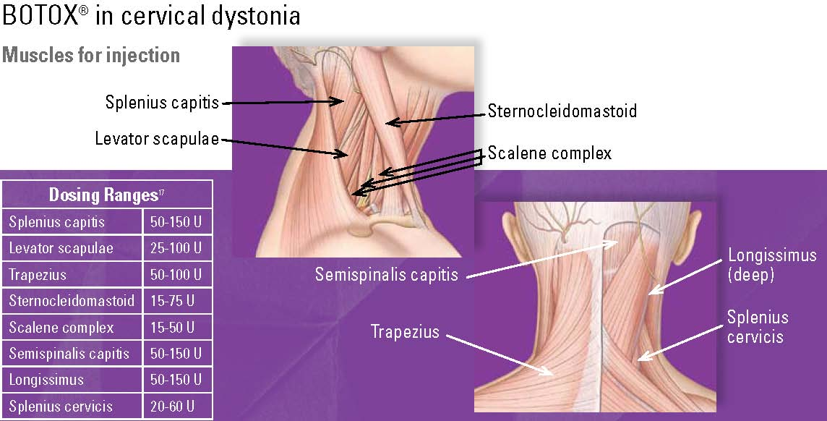
Location and Dosing: Cervical Dystonia^{1,2}
BOTOX® Treatment of Cervical Dystonia
Dosing Ranges^{1,2}
Splenius capitis | 15 - 100 U
Levator scapulae | 20 - 100 U
Trapezius | 20 - 100 U
Sternocleidomastoid | 15 - 100 U
Scalene complex | 15 - 50 U
Semispinalis capitis | 30 - 100 U
Longissimus | 30 - 100 U
Splenius cervicis | 20 - 60 U
Please see BOTOX® and BOTOX ® Cosmetic Important Safety Information including Boxed Warning included in this presentation.
References: 1. BOTOX® [Prescribing Information]. Irvine, CA: Allergan, Inc.; February 2014. 2. Charles D, et al. Continuum Lifelong Learning Neurol.
2010;16(1):131-157.
Notes:
References:
BOTOX® [Prescribing Information]. Irvine, CA: Allergan, Inc.; February 2014.
Charles D, Chandler EG. Neurotoxin injection for movement disorders. Continuum Lifelong Learning Neurol. 2010;16(1):131-157.

Slide 39
Design of Phase 3 BOTOX® (onabotulinumtoxinA) Pivotal Study¹
A phase 3 randomized, multicenter, double-blind, placebo-controlled study of the treatment of cervical dystonia was conducted
This study enrolled adult patients with cervical dystonia and a history of having received BOTOX® in an open-label manner with perceived good response and tolerable side effects
Subjects participated in a 10-week, open-label enrichment period where they received their previously employed dose of BOTOX®. A randomized evaluation was performed up to 6 weeks after completion of the open-label period, at the visit when the subjects' Cervical Dystonia Severity Scale (CDSS) scores returned to 4 or higher. Only patients who were again perceived as showing a response were advanced to the randomized evaluation period
There were 214 subjects evaluated for the open-label period, of which 170 progressed into the randomized, blinded-treatment period (88 in the BOTOX® group, 82 in the placebo group)
Patient evaluations continued for at least 10 weeks post injection
The median total BOTOX® dose in patients receiving BOTOX® (n=88) was 236 Units, with 25th and 75th percentile ranges of 198 Units to 300 Units
The primary outcome of the study was a dual end point, requiring evidence of both a change in the CDSS and an increase in the percentage of patients showing any improvement on the Physician Global Assessment Scale at 6 weeks after injection
Please see BOTOX® and BOTOX ® Cosmetic Important Safety Information including Boxed Warning included
in this presentation.
Reference: 1. BOTOX® [Prescribing Information]. Irvine, CA: Allergan, Inc.; February 2014.
Notes:
Reference:
1. BOTOX® [Prescribing Information]. Irvine, CA: Allergan, Inc.; February 2014.

Slide 40
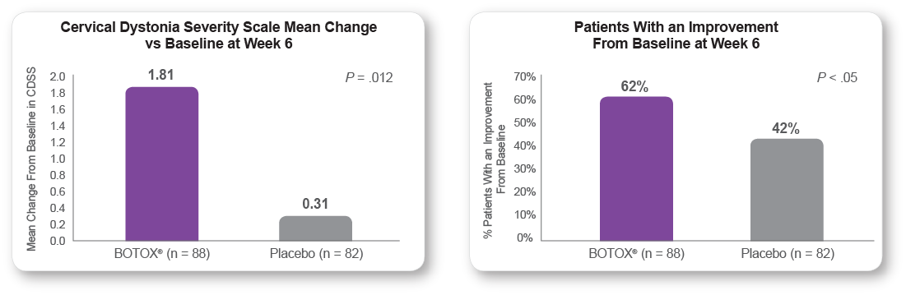
BOTOX® (onabotulinumtoxinA) Provided Significant Benefit in Cervical Dystonia Patients^{1,2}
Head Position Improvement^{2,a}
Physician Global Assessment Improvement^{2,b}
ª Cervical Dystonia Severity Scale (CDSS) quantifies the severity of abnormal head positioning and was devised for this study. CDSS allots 1 point for each 5 degrees (or part thereof) of head deviation in each of the 3 planes of head movement (range of scores up to theoretical maximum of 54).¹
^{B} Physician Global Assessment scale scores range from -4 (very marked worsening of dystonia) to 0 (no change) to +4 (complete abolishment of dystonia symptoms) on patients’ overall change since treatment.¹
Please see BOTOX® and BOTOX ® Cosmetic Important Safety Information including Boxed Warning included in this presentation.
References: 1. BOTOX® (onabotulinumtoxinA) [Prescribing Information]. Irvine, CA: Allergan, Inc.; February 2014. 2. Charles D, et al. Clin Neuropharmacol. 2012;35(5):208-214.
Notes:
References:
BOTOX® (onabotulinumtoxinA) [Prescribing Information]. Irvine, CA: Allergan, Inc.; February 2014.
Charles D, Brashear A, Hauser RA, Li HI, Boo LM, Brin MF; CD 140 Study Group. Efficacy, tolerability, and immunogenicity of onabotulinumtoxinA in a randomized, double-blind, placebo-controlled trial for cervical dystonia. Clin Neuropharmacol. 2012;35(5):208-214.

Slide 41
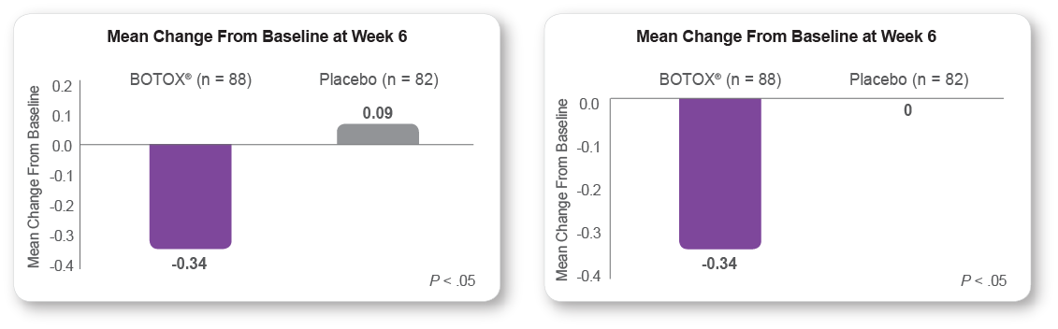
Significant Improvements in Neck Pain
Decrease in Pain Intensity^{1,a}
Decrease in Pain Frequency^{1,b}
ª Pain intensity was evaluated on a scale of 0 (no pain) to 4 (very severe in intensity).¹
^{b} Pain frequency was evaluated on a scale of 0 (no pain) to 4 (constant in frequency).¹
Please see BOTOX® and BOTOX ® Cosmetic Important Safety Information including Boxed Warning included in this presentation.
Reference: 1. Charles D, et al. Clin Neuropharmacol. 2012;35(5):208-214.
Notes:
Reference:
Charles D, Brashear A, Hauser RA, Li HI, Boo LM, Brin MF; CD 140 Study Group. Efficacy, tolerability, and immunogenicity of onabotulinumtoxinA in a randomized, double-blind, placebo-controlled trial for cervical dystonia. Clin Neuropharmacol. 2012;35(5):208-214.

Slide 42
Cervical Dystonia Market Share for BOTOX® (onabotulinumtoxinA) Patients Remains High and Majority of Doses Are Under 200 Units
Month ending…
È
Ç
Base: Treatment opportunities. Data is weighted based on the number of charts.
N/O/P/M: Significantly greater than indicated group at a 95% confidence level. /: Significantly different than previous month at a 95% confidence level. ¢: Small base size. March 15 – 42.
Reference: 1. Data on file. Allergan, Inc.
Please see BOTOX® and BOTOX® Cosmetic Important Safety Information included in this presentation.
Notes:
Reference:
Data on file. Allergan, Inc.

Slide 43
Thank you
Please see BOTOX® full Prescribing Information, including Boxed Warning and Medication Guide available at this presentation.
© 2014 Allergan, Inc. All Rights Reserved.
® marks owned by Allergan, Inc. www.allergan.com APC21TP15

Slide 44
Commitment to the Botulinum Toxin Class: NDO Module
Presented to:
Presented by:
Date:

Slide 45
Over 4.4 Million Americans with a Neurologic Condition Have Detrusor Overactivity¹
Approximately 2.6 million Americans with a neurologic condition have urinary incontinence (UI)¹
Urinary incontinence due to neurogenic detrusor overactivity (NDO) can occur across a range of neurologic injuries or diseases²
Multiple sclerosis (MS)
Spinal cord injury (SCI)
Parkinson’s disease (PD)
Stroke
Please see BOTOX® and BOTOX ® Cosmetic Important Safety Information including Boxed Warning
included in this presentation.
References: 1. Data on file. Allergan, Inc. 2. Denys P, Schnitzler A, Roche N. Euro Urol Suppl. 2006;5: 691-695.
Notes:
Approximately 4.4 million Americans with a neurologic condition (including multiple sclerosis, spinal cord injury, Parkinson’s disease and stroke) have detrusor overactivity. Approximately 2.6 million Americans with a neurologic condition (including multiple sclerosis, spinal cord injury, Parkinson’s disease, and stroke) have urinary incontinence.¹
Urinary incontinence due to neurogenic detrusor overactivity can occur across a range of neurological diseases, including multiple sclerosis, spinal cord injury and Parkinson’s disease, but also can be evident in stroke. Within each disease the severity of neurogenic detrusor overactivity can vary greatly.²
References:
Data on file, Allergan, Inc.
Denys P, Schnitzler A, Roche N. Managing patients with neurogenic detrusor overactivity—a global approach. Eur Urol Suppl. 2006;5:691-695.
45

Slide 46
Administration of BOTOX® (onabotulinumtoxinA)
46
Using a flexible or rigid cystoscope, physicians administer BOTOX® 200 Units¹ as 30, 1 mL injections (~6.7 Units), each spaced approximately 1 cm apart
Patients should not have an acute UTI prior to treatment. Prophylactic antibiotics (except aminoglycosides) should be administered 1-3 days pre-treatment, on the treatment day, and 1-3 days post-treatment¹
Patients should discontinue antiplatelet therapy at least 3 days before the injection procedure. Patients on anticoagulant therapy need to be managed appropriately to decrease the risk of bleeding¹
The recommended dose is 200 Units of BOTOX® per treatment, and should not be exceeded¹
Please see BOTOX® and BOTOX ® Cosmetic Important Safety Information including Boxed Warning
included in this presentation.
Reference: 1. BOTOX® [Prescribing Information]. Irvine, CA: Allergan, Inc. February, 2014.
Notes:
Using a flexible or rigid cystoscope, physicians administer BOTOX® 200 U as 30, 1 mL injections (~6.7 Units) each spaced approximately 1 cm apart
Patients should not have an acute UTI prior to treatment. Prophylactic antibiotics (except aminoglycosides) should be administered 1-3 days pre-treatment, on the treatment day, and 1-3 days post-treatment¹
Patients should discontinue anti-platelet therapy at least 3 days before the injection procedure. Patients on anti-coagulant therapy need to be managed appropriately to decrease the risk of bleeding¹
The recommended dose is 200 U of BOTOX® per treatment, and should not be exceeded¹
Reference:
BOTOX® [Prescribing Information]. Irvine, CA: Allergan, Inc. February, 2014.

Slide 47
Design of Phase 3 BOTOX® (onabotulinumtoxinA) Pivotal Studies¹
Two double-blind, placebo-controlled, randomized, multi-center clinical studies were conducted in patients with urinary incontinence due to detrusor overactivity associated with a neurologic condition who were either spontaneously voiding or using catheterization
A total of 691 patients with spinal cord injury (T1 or below) or multiple sclerosis patients, who had an inadequate response to, or were intolerant of at least one anticholinergic medication, were enrolled
Patients were randomized to receive either 200 Units of BOTOX® (n=227), 300 Units of BOTOX® (n=223), or placebo (n=241)
No additional benefit of BOTOX® 300 Units over 200 Units was demonstrated
Please see BOTOX® and BOTOX ® Cosmetic Important Safety Information including Boxed Warning
included in this presentation.
Reference: 1. BOTOX® [Prescribing Information]. Irvine, CA: Allergan, Inc.; February 2014.
Notes:
Two double-blind, placebo-controlled, randomized, multi-center clinical studies were conducted in patients with urinary incontinence due to detrusor overactivity associated with a neurologic condition who were either spontaneously voiding or using catheterization
A total of 691 patients with spinal cord injury (T1 or below) or multiple sclerosis patients, who had an inadequate response to, or were intolerant of at least one anticholinergic medication, were enrolled
Patients were randomized to receive either 200 Units of BOTOX® (n=227), 300 Units of BOTOX® (n=223), or placebo (n=241)
No additional benefit of BOTOX® 300 Units over 200 Units was demonstrated
Reference:
BOTOX® [Prescribing Information]. Irvine, CA: Allergan, Inc. February, 2014.

Slide 48
Mean Reduction From Baseline in Weekly Urinary Incontinence Episodes
Study 1
Week 2
Week 6
Week 12
Study 2
Week 2
Week 6
Week 12
BOTOX® (onabotulinumtoxinA) patients showed a mean change of -21 and -22 weekly UI episodes at week 6²
Placebo -9 and -13
BOTOX® provided significant reduction in weekly UI episodes as early as week 2 vs. placebo with the full effect observed at week 6 (primary endpoint)^{1,2}
0
0
Placebo , n=146
BOTOX® 200 U, n=134
Placebo, n=91
BOTOX® 200 U, n=91
-5
-5
-10
-10
Mean change from baseline (episodes/week)
Mean change from baseline (episodes/week)
-15
-15
*
**
-20
-20
-25
-25
Mean baseline UI frequency:
BOTOX® 200 U=32.3/wk, Placebo=28.3/wk
Mean baseline UI frequency:
BOTOX® 200 U=32.7/wk, Placebo=36.8/wk
*P<0.001, **P<0.05 in pairwise comparison versus placebo
BOTOX® (onabotulinumtoxinA) Prescribing Information. Allergan, Inc., 2011.
Please see BOTOX® and BOTOX ® Cosmetic Important Safety Information including Boxed Warning
included in this presentation.
Reference: 1. BOTOX® [Prescribing Information]. Irvine, CA: Allergan, Inc.; February 2014. 2. Data on file, Allergan, Inc.
Notes:
In both studies, significant improvement in the primary efficacy variable of change from baseline in weekly frequency of UI episodes was achieved with BOTOX® 200 Units compared with placebo at the primary efficacy time point of week 6 (P<0.001 and P<0.05 for Studies 1 and 2, respectively).
The figure presents the mean (average) reduction of weekly urinary incontinence episodes for each group. The differences between BOTOX® 200 Units and placebo are statistically significant in the two pivotal studies.
NOTE: If a question arises about the data in the weekly urinary incontinence episodes tables in our package insert: the mean (average) changes presented in the tables are the adjusted mean changes based on the analysis of covariance model (ANCOVA). The adjustments were made for baseline incontinence episodes, etiology, anticholinergic therapy at screening, and investigator sites. The differences between BOTOX® 200 Units and placebo are statistically significant in the two pivotal studies when analyzed by arithmetic mean and ANCOVA analysis.
Reference:
BOTOX® [Prescribing Information]. Irvine, CA: Allergan, Inc.; February 2014.
Data on file, Allergan, Inc. Clinical Study Report. Study Number 191622-515. September 1, 2010.
Data on file, Allergan, Inc. Clinical Study Report. Study Number 191622-516. September 1, 2010.

Slide 49
Adverse Reactions Reported by >2% of BOTOX® treated Patients and More Frequent than in Placebo-treated Patients Within the First 12 Weeks after Intradetrusor Injection in Double-blind, Placebo-controlled Clinical Trials¹*
Adverse Reactions | BOTOX® 200 Units (N=262) | Placebo (N=272)
Urinary tract infection | 64 (24%) | 47 (17%)
Urinary retention | 45 (17%) | 8 (3%)
Hematuria | 10 (4%) | 8 (3%)
*The following adverse reactions with BOTOX® 200 Units were reported at any time following initial injection and prior to re-injection or study exit (median duration of 44 weeks exposure): urinary tract infections (49%), urinary retention (17%), constipation (4%), muscular weakness (4%), dysuria (4%), fall (3%) gait disturbance (3%), and muscle spasm (2%).
In the MS patients enrolled in the double-blind, placebo-controlled trials, the MS exacerbation annualized rate (i.e., number of MS exacerbation events per patient-year) was 0.23 for BOTOX® and 0.20 for placebo
Please see BOTOX® and BOTOX ® Cosmetic Important Safety Information including Boxed Warning
included in this presentation.
Reference: 1. BOTOX® [Prescribing Information]. Irvine, CA: Allergan, Inc.; February 2014.

Slide 50
Thank you
Please see BOTOX® full Prescribing Information, including Boxed Warning and Medication Guide available at this presentation.
© 2014 Allergan, Inc. All Rights Reserved.
® marks owned by Allergan, Inc. www.allergan.com APC24OT14

Slide 51
Commitment to the Botulinum Toxin Class: Chronic Migraine Module
Presented to:
Presented by:
Date:

Slide 52
Chronic Migraine: A Severe and Disabling Headache Disorder
ICHD3-beta
Diagnostic Criteria for Chronic
Migraine (2013)¹
Practical Clinical Criteria
for Chronic Migraine²
Headache ≥ 15 days/month for > 3 months with ≥ 5 prior migraine attacks (with/without aura)
On ≥ 8 days/month for > 3 months, headache fulfills the criteria for migraine
Not attributed to another causative disorder
With or without medication overuse
Headache on ≥ 15 days per month
AND
Headaches last ≥ 4 hours per day and ≥ 8 headache days are migraine
AND
With or without medication overuse
Please see BOTOX® and BOTOX ® Cosmetic Important Safety Information including Boxed Warning included in this presentation.
References: 1. Headache Classification Committee of the International Headache Society (IHS), Cephalalgia. 2013;33(9):629-808. 2. Lipton RB. Headache. 2011;51(Suppl 2):77-83.
Notes:
References:
Headache Classification Committee of the International Headache Society (IHS). The International Classification of Headache Disorders, 3rd edition (beta version). Cephalalgia. 2013; 33(9):629-808. doi: 10.1177/0333102413485658.
Lipton RB. Chronic migraine, classification, differential diagnosis, and epidemiology. Headache. 2011;51(Suppl 2):77-83. doi: 10.1111/j.1526-4610.2011.01954.x.

Slide 53
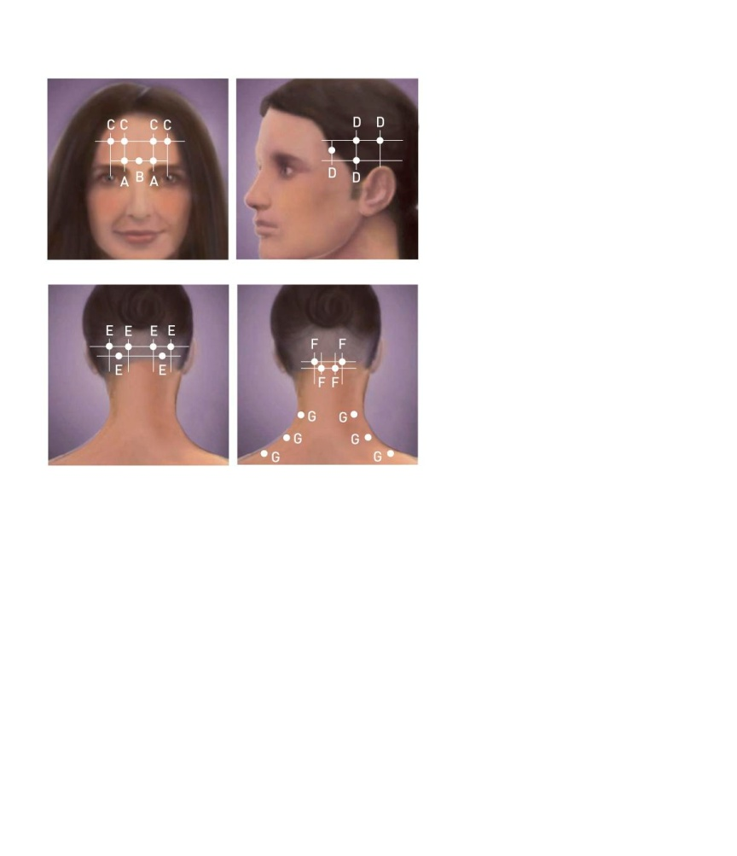
Location and Dosing: Chronic Migraine
Chronic Migraine
BOTOX® (onabotulinumtoxinA) for injection is indicated for the prophylaxis of headaches in adult patients with chronic migraine (≥15 days per month with headache lasting 4 hours a day or longer).
Important limitations
Safety and effectiveness have not been established for the prophylaxis of episodic migraine (14 headache days or fewer per month) in seven placebo-controlled studies.
Dosing by muscle and recommended injection sites for chronic migraine patients¹
The dosing and administration of BOTOX® is a detailed process. The information on this page contains highlights only and is not meant to be a substitute for appropriate training or review of full Prescribing Information.
Head/Neck Area | Recommended Dose (Number of Sitesª)
Frontalis^{b} | 20 Units divided in 4 sites
Corrugator^{b} | 10 Units divided in 2 sites
Procerus | 5 Units in 1 site
Occipitalis^{b} | 30 Units divided in 6 sites
Temporalis^{b} | 40 Units divided in 8 sites
Trapezius^{b} | 30 Units divided in 6 sites
Cervical paraspinal muscle group^{b} | 20 Units divided in 4 sites
Total Dose: | 155 Units divided in 31 sites
ª Each IM injection site = 0.1 mL = 5 Units BOTOX®. ^{b} Dose distributed bilaterally.
Corrugator:5 U each side
Procerus: 5 U (one site)
Frontalis: 10 U each side
Temporalis: 20 U each side
Occipitalis: 15 U each side
Cervical paraspinal: 10 U each side
Trapezius: 15 U each side
The recommended dilution is 200 Units/4mL or 100 Units/2mL with a final concentration of 5 Units per 0.1mL (see sections 2.1 and 2.2 of the full Prescribing Information for preparation and dilution techniques and additional dosing information).
Please see BOTOX® and BOTOX ® Cosmetic Important Safety Information including Boxed Warning included in this presentation.
Reference: 1. BOTOX® [Prescribing Information]. Irvine, CA: Allergan, Inc.; February 2014.
Notes:
Reference:
1. BOTOX® [Prescribing Information]. Irving, CA: Allergan, Inc.; February 2014.

Slide 54
Summary of BOTOX® (onabotulinumtoxinA) Study Design¹
Two randomized, multi-center, 24-week, 2 injection cycle, placebo-controlled double-blind clinical studies
Study 1 and Study 2 included chronic migraine adults who were not using any concurrent headache prophylaxis, and during a 28-day baseline period had ≥ headache days lasting 4 hours or more, with ≥ 50% being migraine/probable migraine
In both studies, patients were randomized to receive placebo or 155 Units of BOTOX® injections every 12 weeks for the 2-cycle, double-blind phase
Patients were allowed to use acute headache treatments during the study
BOTOX® treatment demonstrated statistically significant and clinically meaningful improvements from baseline compared to placebo for key efficacy variables
Please see BOTOX® and BOTOX ® Cosmetic Important Safety Information including Boxed Warning included in this presentation.
Reference: 1. BOTOX® [Prescribing Information]. Irvine, CA: Allergan, Inc.; February 2014.
Notes:
Reference:
1. BOTOX® [Prescribing Information]. Irving, CA: Allergan, Inc.; February 2014.

Slide 55
Results of BOTOX® (onabotulinumtoxinA) Clinical Studies for the Treatment of Chronic Migraine Patients
BOTOX® treatment demonstrated statistically significant and clinically meaningful improvements from baseline compared to placebo for efficacy variables¹⁻³
Week 24 efficacy variables for Study 1 and Study 2
 | Study 1¹ |  | Study 2¹
Efficacy per 28 Days | BOTOX® (n=341) | Placebo (n=338) | BOTOX® (n=347) | Placebo (n=358)
Change from baseline in frequency of headache days | -7.8ª | -6.4 | -9.2ª | -6.9
Change from baseline in total cumulative hours of headache on headache days | -107ª | -70 | -134ª | -95
ª Significantly different from placebo (P ≤ .05).
Please see BOTOX® and BOTOX ® Cosmetic Important Safety Information including Boxed Warning included in this presentation.
References: 1. BOTOX® [Prescribing Information]. Irvine, CA: Allergan, Inc.; 2014. 2. Aurora SK, Dodick DW, Turkel CC, et al. Cephalalgia. 2010;30(7):793-803. 3. Diener HC, Dodick DW, Aurora SK, et al. Cephalalgia. 2010;30(7):804-814.
Notes:
References:
BOTOX® [Prescribing Information]. Irvine, CA: Allergan, Inc.; February 2014.
Aurora SK, Dodick DW, Turkel CC, DeGryse RE, Silberstein SD, Lipton RB, Diener HC, Brin MF; PREEMPT 1 Chronic Migraine Study Group. OnabotulinumtoxinA for treatment of chronic migraine: results from the double-blind, randomized, placebo-controlled phase of the PREEMPT 1 trial. Cephalalgia. 2010;30(7):793-803.
Diener HC, Dodick DW, Aurora SK, Turkel CC, DeGryse RE, Lipton RB, Silberstein SD, Brin MF; PREEMPT 2 Chronic Migraine Study Group. OnabotulinumtoxinA for treatment of chronic migraine: results from the double-blind, randomized, placebo-controlled phase of the PREEMPT 2 trial. Cephalalgia. 2010;30(7):804-814.

Slide 56
Adverse Reactions Reported by >2% of BOTOX® (onabotulinumtoxinA) treated Patients and More Frequent than in Placebo-treated Patients in Two Chronic Migraine Double-blind, Placebo-controlled Clinical Trials^{1*}
Adverse Reactions by System Organ Class | BOTOX® 155 Units-195 Units (N=687) | Placebo (N=692)
Nervous system disorders Headache Migraine Facial paresis | 32 (5%) 26 (4%) 15 (2%) | 22 (3%) 18 (3%) 0 (0%)
Eye disorders Eyelid ptosis | 25 (4%) | 2 (˂1%)
Infections and infestations Bronchitis | 17 (3%) | 11 (2%)
Musculoskeletal and connective tissue disorders Neck pain Musculoskeletal stiffness Muscular weakness Myalgia Musculoskeletal pain Muscle spasms | 60 (9%) 25 (4%) 24 (4%) 21 (3%) 18 (3%) 13 (2%) | 19 (3%) 6 (1%) 2 (<1%) 6 (1%) 10 (1%) 6 (1%)
General disorders and administration site conditions Injection site pain | 23 (3%) | 14 (2%)
Vascular disorders Hypertension | 11 (2%) | 7 (1%)
*Other adverse reactions that occurred more frequently in the BOTOX® group compared to the placebo group at a frequency less than 1% and potentially BOTOX® related include: vertigo, dry eye, eyelid edema, dysphagia, eye infection, and jaw pain. Severe worsening of migraine requiring hospitalization occurred in approximately 1% of BOTOX® treated patients in Study 1 and Study 2, usually within the first week after treatment, compared to 0.3% of placebo-treated patients.
Please see BOTOX® and BOTOX ® Cosmetic Important Safety Information including Boxed Warning included in this presentation.
Reference: 1. BOTOX® [Prescribing Information]. Irvine, CA: Allergan, Inc.; February, 2014.
Notes:
Reference:
1. BOTOX® [Prescribing Information]. Irving, CA: Allergan, Inc.; February 2014.

Slide 57
Thank you
Please see BOTOX® full Prescribing Information, including Boxed Warning and Medication Guide available at this presentation.
© 2014 Allergan, Inc. All Rights Reserved.
® marks owned by Allergan, Inc. www.allergan.com APC55RF14

Slide 58
Commitment to the Botulinum Toxin Class: Differentiation Module
Presented to:
Presented by:
Date:

Slide 59
FDA Recommends Increased Safety Measures for Botulinum Toxin Products
The FDA has mandated class label changes to increase safety and minimize the risk of medication error for botulinum toxins (BoNTs). This recommendation extends to all manufacturers of botulinum toxins to include¹:
Safety language and boxed warning pertaining to the distant spread of toxin from the injection site to other areas of the body
Language on non-interchangeability and difference in potency assay methods used
Nomenclature differentiation among products (i.e. onabotulinumtoxinA, abobotulinumtoxinA, incobotulinumtoxinA, rimabotulinumtoxinB)²⁻⁵
REMS program to include
Medication guide
Communication plan
Safety data collection
Please see BOTOX® and BOTOX® Cosmetic Indications, Important Limitations, and Important Safety Information including Boxed Warning throughout this presentation.
References: 1. Food and Drug Administration Web site. Available at http://www.fda.gov/bbs/topics/NEWS/2009/NEW02005.html. Accessed April 30, 2009. 2. BOTOX® [Prescribing Information]. Irvine, CA: Allergan, Inc.; February 2014. 3. Myobloc [Prescribing Information]. Malvern, PA: Solstice Neurosciences, Inc.; May 2010. 4. Dysport [Prescribing Information]. Basking Ridge, NJ: Ipsen Biopharm Ltd.; March 2012. 5. Xeomin [Prescribing Information]. Greensboro, NC: Merz Pharmaceuticals, LLC.; April 2014.
Notes:
59

Slide 60
Dose Conversion Is Not Established
For simple chemical molecules, the mechanism to establish bioequivalence is streamlined through the use of standardized pharmacokinetic criteria¹
For complex biological molecules, standard pharmacokinetic criteria are neither relevant nor measurable
Bioequivalence in biologics has yet to be established
Communication on biosimilars²
"…as of today, the FDA has not determined how interchangeability can be established for complex proteins."
"Different large protein products with similar molecular composition may behave differently in people, and substitution of one for the other may result in serious health outcomes…"
"The issue of interchangeability is not an issue of nomenclature but a scientific question to be determined on its own merit."
Please see BOTOX® and BOTOX® Cosmetic Indications, Important Limitations, and Important Safety Information including Boxed Warning throughout this presentation.
References: 1. Sampaio C. Mov Disord. 2004;19(S8):S129-S136. 2. FDA/CDER. U.S. FDA Considerations: Discussion by National Regulatory Authorities with World Health Organization (WHO) On Possible International Non-proprietary Name (INN) Policies for Biosimilars. September 1, 2006. http://www.fda.gov/cder/news/biosimilars.htm. Accessed August 8, 2008.
Notes:
60

Slide 61
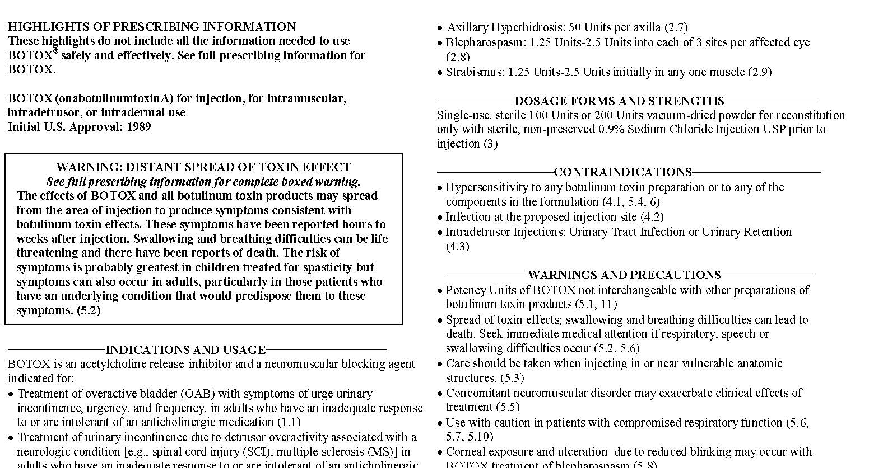
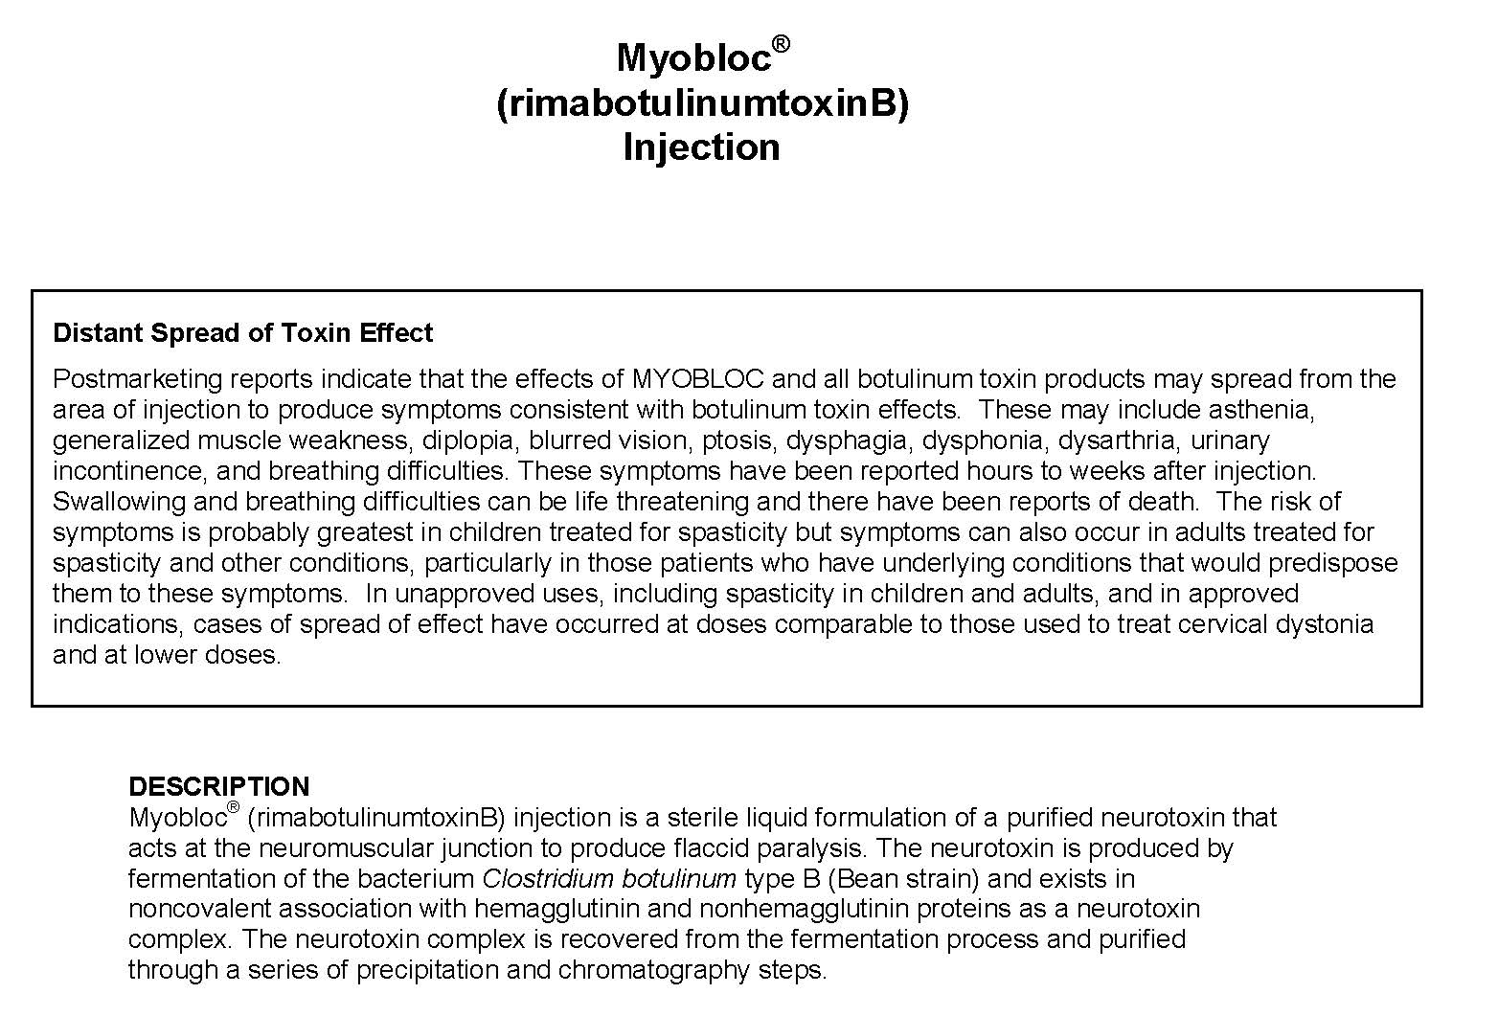

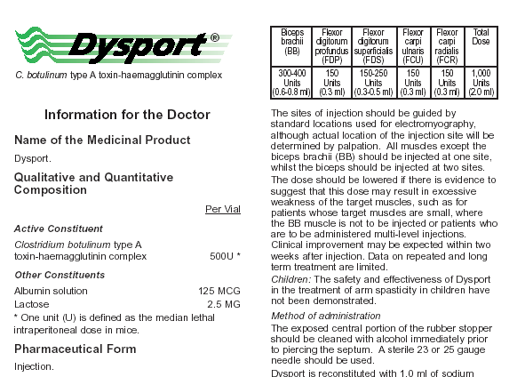
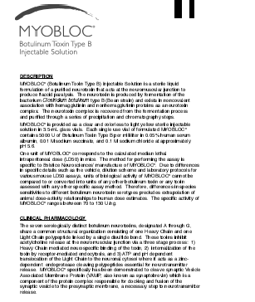
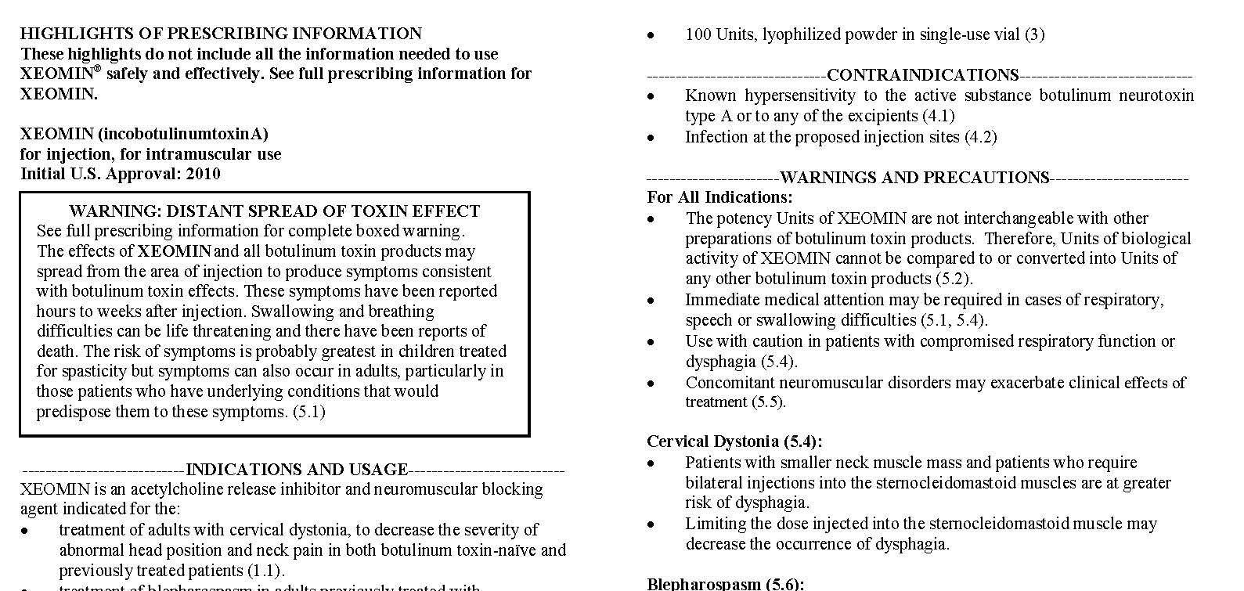
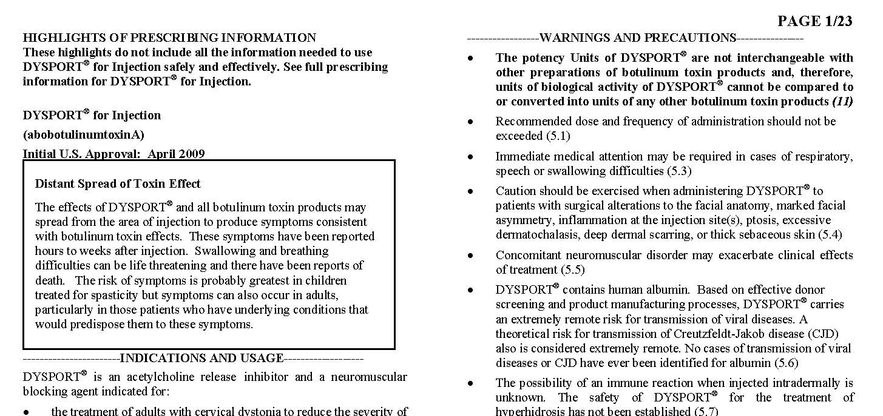
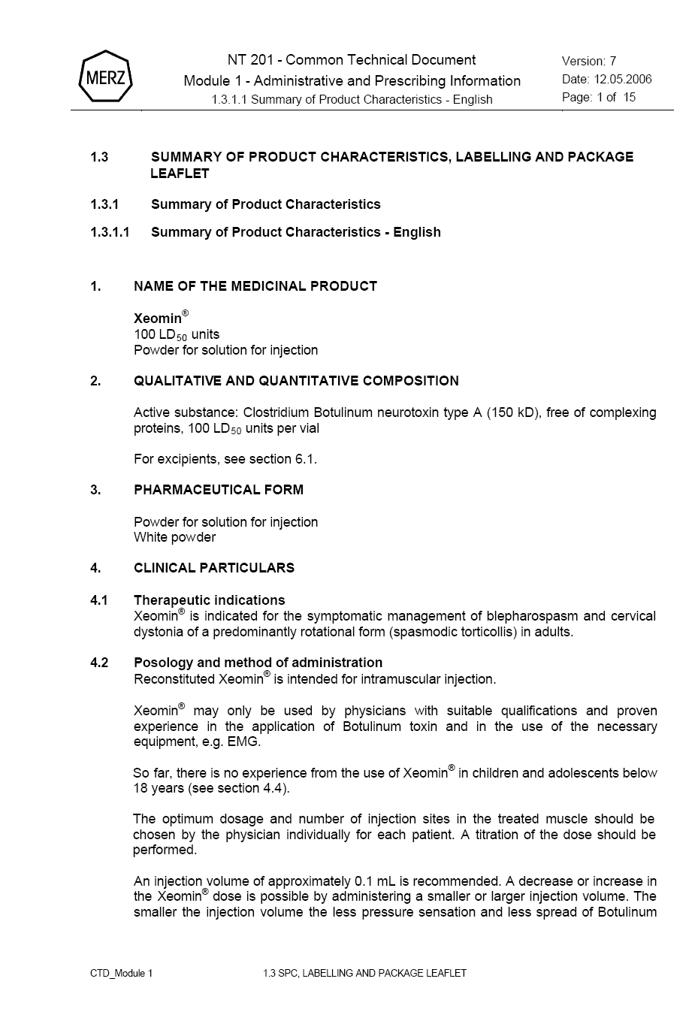
Recognized Importance of Non-Interchangeability and Non-Conversion for BoNTs
“Units of biological activity of BOTOX® (onabotulinumtoxinA) cannot be compared to nor converted into units of any other botulinum toxin…” ¹
“Units of biological activity of Myobloc® cannot be compared to or converted into units of any other botulinum toxin …” ³
“Units of biological activity of Dysport® cannot be compared to or converted into units of any other botulinum toxin…” ²
“Units of biological activity of Xeomin® cannot be compared to or converted into units of any other botulinum toxin…” ⁴
Please see BOTOX® and BOTOX® Cosmetic Indications, Important Limitations, and Important Safety Information, including Boxed Warning, throughout this presentation.
References: 1. BOTOX® [Prescribing Information]. Irvine, CA: Allergan, Inc.; February 2014. 2. Dysport [Prescribing Information]. Basking Ridge, NJ: Ipsen Biopharm Ltd.; March 2012. 3. Myobloc [Prescribing Information]. Malvern, PA: Solstice Neurosciences, Inc.; May 2010. 4. Xeomin [Prescribing Information]. Greensboro, NC: Merz Pharmaceuticals, LLC.; April 2014.
Notes:
61

Slide 62
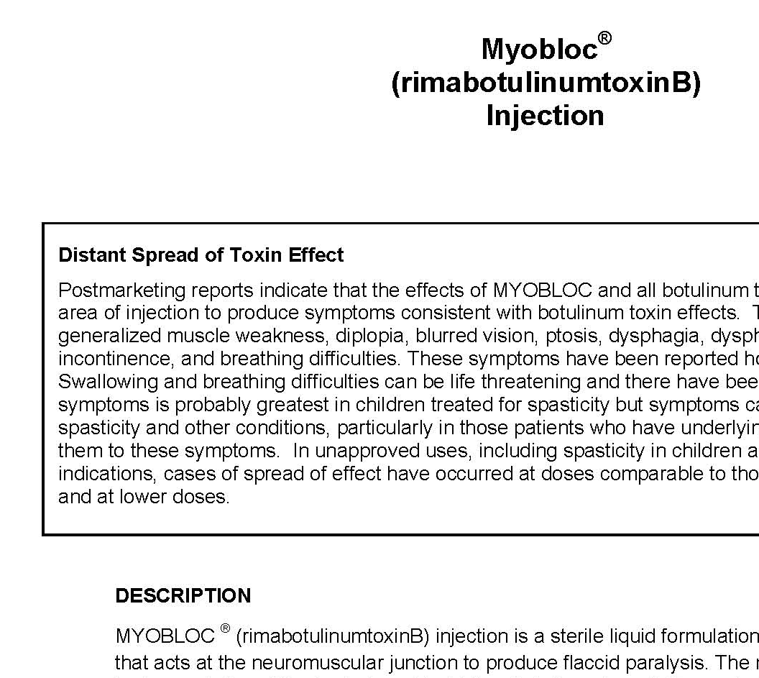
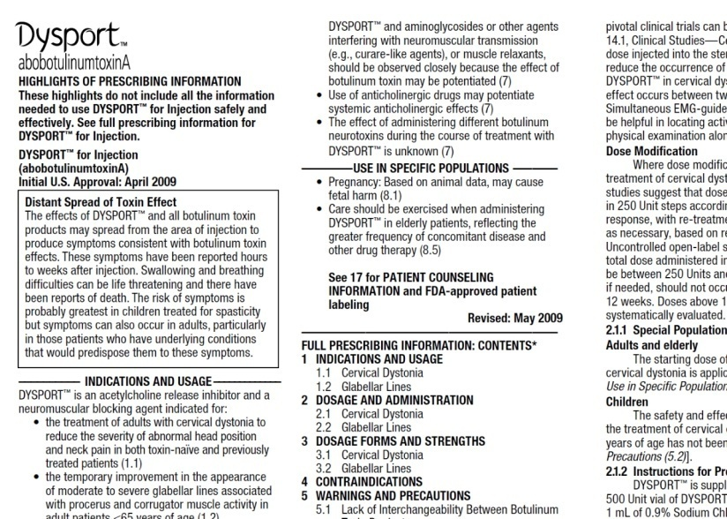
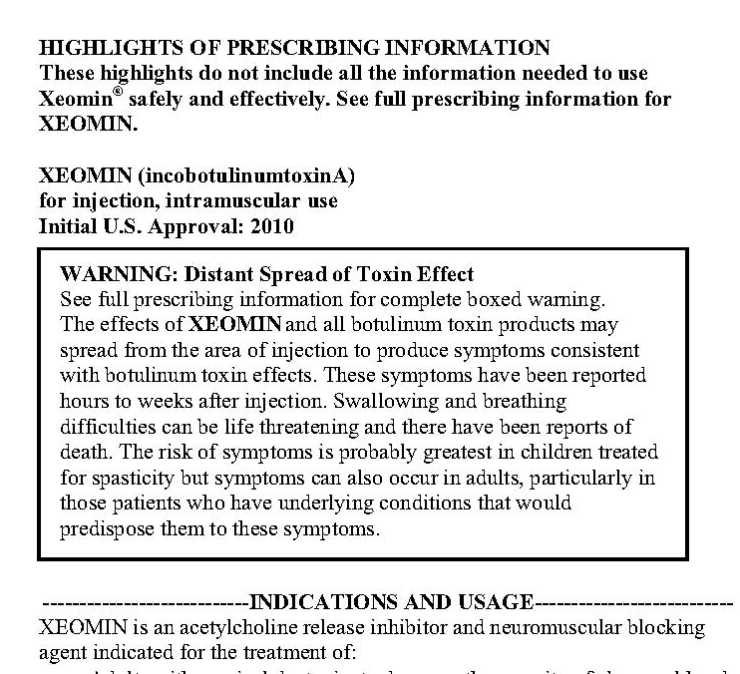
Recognized Importance of Differences in Unit Potency for BoNTs
“The assay is specific to Allergan’s products BOTOX® and BOTOX® Cosmetic.” ¹
“The method for performing the assay is specific to Solstice Neurosciences’ manufacture of MYOBLOC®.” ³
“The method for conducting the assay is specific to XEOMIN, Units of biological activity of XEOMIN
cannot be converted into Units of any other botulinum toxin assessed with other specific assays..” ⁴
“The method for performing the assay is specific to Ipsen’s product Dysport®.” ²
Please see BOTOX® and BOTOX® Cosmetic Indications, Important Limitations, and Important Safety Information including Boxed Warning throughout this presentation.
References: 1. BOTOX® [Prescribing Information]. Irvine, CA: Allergan, Inc.; February 2014. 2. Dysport [Prescribing Information]. Basking Ridge, NJ: Ipsen Biopharm Ltd.; March 2012. 3. Myobloc [Prescribing Information]. Malvern, PA: Solstice Neurosciences, Inc.; May 2010. 4. Xeomin [Prescribing Information]. Greensboro, NC: Merz Pharmaceuticals, LLC.; April 2014.
Notes:
62
Due to clear differences between commercial BoNT products, imparted through the manufacturing and formulation process, regulatory agencies world-wide have mandated specific language in product labeling stating that units of biologic activity are not interchangeable nor simply converted between products.
References:
BOTOX® [Prescribing Information]. Irvine, CA: Allergan, Inc.; February 2014.
Dysport® [Prescribing Information]. Basking Ridge, NJ: Ipsen Biopharm Ltd. March 2012.
Myobloc® [Prescribing Information]. South San Francisco, CA: Solstice Neurosciences, Inc. May 2010.
Xeomin® [Prescribing Information]. Greensboro, NC: Merz Pharmaceuticals, LLC. April 2014.

Slide 63
Product Prescribing Information Shows Differences in Dosing for BoNTs Based on Approved Indications (Cervical Dystonia)
Subjects in Study #301 were randomized to receive placebo, 5,000 Units or 10,000 Units of Myobloc®, and subjects in Study #302 were randomized to receive placebo or 10,000 Units of Myobloc®.³
In this study the median total BOTOX® (onabotulinumtoxinA) dose in patients randomized to receive BOTOX® (N=88) was 236 Units, with 25th to 75th percentile ranges of 198 Units to 300 Units.¹
The recommended initial total dose of Xeomin® for cervical dystonia is 120 Units. In a placebo-controlled trial utilizing initial Xeomin® doses of 120 Units and 240 Units, no meaningful difference in effectiveness was demonstrated between the doses.⁴
Initial dose of Dysport® is 500 Units given intramuscularly as a divided dose among affected muscles. Titration should occur in 250 Unit steps according to patient’s response.²
Please see BOTOX® and BOTOX® Cosmetic Indications, Important Limitations, and Important Safety Information including Boxed Warning throughout this presentation.
References: 1. BOTOX® [Prescribing Information]. Irvine, CA: Allergan, Inc.; February 2014. 2. Dysport [Prescribing Information]. Basking Ridge, NJ: Ipsen Biopharm Ltd.; March 2012. 3. Myobloc [Prescribing Information]. Malvern, PA: Solstice Neurosciences, Inc.; May 2010. 4. Xeomin [Prescribing Information]. Greensboro, NC: Merz Pharmaceuticals, LLC.; April 2014.
.
Notes:
Due to clear differences between commercial BoNT products, imparted through the manufacturing and formulation process, regulatory agencies world-wide have mandated specific language in product labeling stating that units of biologic activity are not interchangeable nor simply converted between products.
References:
BOTOX® [Prescribing Information]. Irvine, CA: Allergan, Inc.; February 2014.
Dysport® [Prescribing Information]. Basking Ridge, NJ: Ipsen Biopharm Ltd. March 2012.
Myobloc® [Prescribing Information]. South San Francisco, CA: Solstice Neurosciences, Inc. May 2010.
Xeomin® [Prescribing Information]. Greensboro, NC: Merz Pharmaceuticals, LLC. April 2014.

Slide 64
Thank you
Note to presenter: Please provide full prescribing information including Boxed Warning and Medication Guide when presenting this material.
© 2015 Allergan, Inc. All Rights Reserved.
® marks owned by Allergan, Inc. www.allergan.com APC67GY15

Slide 65
Summary
Allergan leadership in neurotoxin development
Eight therapeutic indications approved by the FDA¹, each one requiring a different dose and injection location:
Overactive bladder (second-line to an anticholinergic)
Urinary incontinence due to detrusor overactivity associated with a neurologic activity (second-line to an anticholinergic)
Chronic migraine
Upper limb spasticity
Cervical dystonia
Blepharospasm and strabismus
Severe primary axillary hyperhidrosis inadequately managed with topical agents
Allergan provides education and injector training to specialists administering BOTOX® (onabotulinumtoxinA)
Commitment to patient support groups and injectors
Patient support groups
Patient assistance
Please see BOTOX® and BOTOX® Cosmetic Important Safety Information included in this presentation.
Reference: 1. BOTOX® [prescribing information]. Irvine, CA: Allergan, Inc. February, 2014.

Slide 66
Summary (continued)
BOTOX® is a complex molecule that demonstrates clinical evidence of long duration¹
Differences exist among toxins²
Non-interchangeability
Potency units cannot be compared nor converted to units of another toxin
Dose and unit potency differences exist
FDA-mandated new botulinum toxin product labeling including information about non-interchangeability and difference in potency assay methods used, a Boxed Warning regarding the potential risk of distant spread of toxin from the injection site, and established name differentiation among products to help reduce the risk of medication error²
Please see BOTOX® and BOTOX® Cosmetic Important Safety Information included in this presentation.
References: 1. BOTOX® [prescribing information]. Irvine, CA: Allergan, Inc. February, 2014. 2. Food and Drug Administration Website. Available at http://www.fda.gov/bbs/topics/NEWS/2009/NEW02005.html. Accessed April 30, 2009.

Slide 67
Considerations for an Evidence-Based Medical Policy: BOTOX® (onabotulinumtoxinA)
Leadership in neurotoxins:
Established clinical efficacy in 8 FDA-approved indications
Extensively researched
All botulinum toxins require different unit potency among the indications
Consider the differences in botulinum toxins when creating medical policy
Please see BOTOX® and BOTOX® Cosmetic Important Safety Information included in this presentation.

Slide 68
BOTOX® (onabotulinumtoxinA) & BOTOX® Cosmetic (onabotulinumtoxinA) Important Safety Information
IMPORTANT SAFETY INFORMATION, INCLUDING BOXED WARNING
WARNING: DISTANT SPREAD OF TOXIN EFFECT
Postmarketing reports indicate that the effects of BOTOX® and all botulinum toxin products may spread from the area of injection to produce symptoms consistent with botulinum toxin effects. These may include asthenia, generalized muscle weakness, diplopia, ptosis, dysphagia, dysphonia, dysarthria, urinary incontinence, and breathing difficulties. These symptoms have been reported hours to weeks after injection. Swallowing and breathing difficulties can be life threatening, and there have been reports of death. The risk of symptoms is probably greatest in children treated for spasticity, but symptoms can also occur in adults treated for spasticity and other conditions, particularly in those patients who have an underlying condition that would predispose them to these symptoms. In unapproved uses, including spasticity in children, and in approved indications, cases of spread of effect have been reported at doses comparable to those used to treat cervical dystonia and at lower doses.
Please see additional Important Safety Information on the next slide.

Slide 69
BOTOX® (onabotulinumtoxinA) & BOTOX® Cosmetic (onabotulinumtoxinA) Important Safety Information
Indications
Bladder Dysfunction:
Overactive Bladder
BOTOX® for injection is indicated for the treatment of overactive bladder with symptoms of urge urinary incontinence, urgency, and frequency, in adults who have an inadequate response to or are intolerant of an anticholinergic medication.
Detrusor Overactivity Associated With a Neurologic Condition
BOTOX® for injection is indicated for the treatment of urinary incontinence due to detrusor overactivity associated with a neurologic condition (eg, SCI, MS) in adults who have an inadequate response to or are intolerant of an anticholinergic medication.
Chronic Migraine
BOTOX® for injection is indicated for the prophylaxis of headaches in adult patients with chronic migraine (≥ 15 days per month with headache lasting 4 hours a day or longer).
Important Limitations
Safety and effectiveness have not been established for the prophylaxis of episodic migraine (14 headache days or fewer per month) in 7 placebo-controlled studies.
Upper Limb Spasticity
BOTOX® for injection is indicated for the treatment of upper limb spasticity in adult patients, to decrease the severity of increased muscle tone in elbow flexors (biceps), wrist flexors (flexor carpi radialis and flexor carpi ulnaris), and finger flexors (flexor digitorum profundus and flexor digitorum sublimis).
Important Limitations
Safety and effectiveness of BOTOX® have not been established for the treatment of other upper limb muscle groups, or for the treatment of lower limb spasticity. Safety and effectiveness of BOTOX® have not been established for the treatment of spasticity in pediatric patients under age 18 years. BOTOX® has not been shown to improve upper extremity functional abilities, or range of motion at a joint affected by a fixed contracture. Treatment with BOTOX® is not intended to substitute for usual standard of care rehabilitation regimens.
Please see additional Indications and Important Safety Information on the next slide.

Slide 70
BOTOX® (onabotulinumtoxinA) & BOTOX® Cosmetic (onabotulinumtoxinA) Important Safety Information (continued)
Cervical Dystonia
BOTOX® is indicated for the treatment of adults with cervical dystonia to reduce the severity of abnormal head position and neck pain associated with cervical dystonia.
Blepharospasm and Strabismus
BOTOX® is indicated for the treatment of strabismus and blepharospasm associated with dystonia, including benign essential blepharospasm or VII nerve disorders in patients 12 years of age and above.
Primary Axillary Hyperhidrosis
BOTOX® is indicated for the treatment of severe primary axillary hyperhidrosis that is inadequately managed with topical agents. Important Limitations
The safety and effectiveness of BOTOX® for hyperhidrosis in other body areas have not been established. Weakness of hand muscles and blepharoptosis may occur in patients who receive BOTOX® for palmar hyperhidrosis and facial hyperhidrosis, respectively. Patients should be evaluated for potential causes of secondary hyperhidrosis (eg, hyperthyroidism) to avoid symptomatic treatment of hyperhidrosis without the diagnosis and/or treatment of the underlying disease. Safety and effectiveness of BOTOX® have not been established for the treatment of axillary hyperhidrosis in pediatric patients under age 18.
Glabellar Lines
BOTOX® Cosmetic is indicated for the temporary improvement in the appearance of moderate to severe glabellar lines associated with corrugator and/or procerus muscle activity in patients 18 to 65 years of age. Lateral Canthal Lines BOTOX® Cosmetic is indicated for the temporary improvement in the appearance of moderate to severe lateral canthal lines associated with orbicularis oculi activity in adult patients.
Please see additional Important Safety Information on the next slide.

Slide 71
BOTOX® (onabotulinumtoxinA) & BOTOX® Cosmetic (onabotulinumtoxinA) Important Safety Information (continued)
IMPORTANT SAFETY INFORMATION (cont.)
CONTRAINDICATIONS
BOTOX® and BOTOX® Cosmetic are contraindicated in the presence of infection at the proposed injection site(s) and in individuals with known hypersensitivity to any botulinum toxin preparation or to any of the components in the formulation. Intradetrusor injection of BOTOX® is contraindicated in patients with overactive bladder or detrusor overactivity associated with a neurologic condition who have a urinary tract infection (UTI). Intradetrusor injection of BOTOX® is also contraindicated in patients with urinary retention and in patients with post-void residual (PVR) urine volume >200 mL, who are not routinely performing clean intermittent self-catheterization (CIC).
WARNINGS AND PRECAUTIONS
Lack of Interchangeability Between Botulinum Toxin Products
The potency Units of BOTOX® and BOTOX® Cosmetic are specific to the preparation and assay method utilized. They are not interchangeable with other preparations of botulinum toxin products and, therefore, units of biological activity of BOTOX® and BOTOX® Cosmetic cannot be compared to nor converted into units of any other botulinum toxin products assessed with any other specific assay method.
Spread of Toxin Effect
See Boxed Warning.
No definitive serious adverse event reports of distant spread of toxin effect associated with dermatologic use of BOTOX®/BOTOX® Cosmetic at the labeled dose of 20 Units (for glabellar lines) or at the labeled dose of 100 Units (for severe primary axillary hyperhidrosis) have been reported. No definitive serious adverse event reports of distant spread of toxin effect associated with BOTOX® for blepharospasm at the recommended dose (30 Units and below), strabismus, or chronic migraine at the labeled doses have been reported.
Please see additional Important Safety Information on the next slide.

Slide 72
BOTOX® (onabotulinumtoxinA) & BOTOX® Cosmetic (onabotulinumtoxinA) Important Safety Information (continued)
Injections In or Near Vulnerable Anatomic Structures
Care should be taken when injecting in or near vulnerable anatomic structures. Serious adverse events including fatal outcomes have been reported in patients who had received BOTOX® injected directly into salivary glands, the oro-lingual-pharyngeal region, esophagus and stomach. Some patients had pre-existing dysphagia or significant debility. (Safety and effectiveness have not been established for indications pertaining to these injection sites.) Pneumothorax associated with injection procedure has been reported following the administration of BOTOX® near the thorax. Caution is warranted when injecting in proximity to the lung, particularly the apices. Hypersensitivity Reactions
Serious and/or immediate hypersensitivity reactions have been reported. These reactions include anaphylaxis, serum sickness, urticaria, soft-tissue edema, and dyspnea. If such a reaction occurs, further injection of BOTOX® or BOTOX® Cosmetic should be discontinued and appropriate medical therapy immediately instituted. One fatal case of anaphylaxis has been reported in which lidocaine was used as the diluent, and consequently the causal agent cannot be reliably determined. Dysphagia and Breathing Difficulties in Treatment of Cervical Dystonia
Treatment with BOTOX® and other botulinum toxin products can result in swallowing or breathing difficulties. Patients with pre-existing swallowing or breathing difficulties may be more susceptible to these complications. When distant effects occur, additional respiratory muscles may be involved (see Boxed Warning). Pre-Existing Neuromuscular Disorders
Individuals with peripheral motor neuropathic diseases, amyotrophic lateral sclerosis, or neuromuscular junctional disorders (eg, myasthenia gravis or Lambert-Eaton syndrome) should be monitored particularly closely when given botulinum toxin. Patients with neuromuscular disorders may be at increased risk of clinically significant effects including severe dysphagia and respiratory compromise from therapeutic doses of BOTOX®.
Please see additional Important Safety Information on the next slide.

Slide 73
BOTOX® (onabotulinumtoxinA) & BOTOX® Cosmetic (onabotulinumtoxinA) Important Safety Information (continued)
Pulmonary Effects of BOTOX® in Patients With Compromised Respiratory Status Treated for Spasticity or for Detrusor Overactivity Associated With a Neurologic Condition
Patients with compromised respiratory status treated with BOTOX® for upper limb spasticity or detrusor overactivity associated with a neurologic condition should be monitored closely. Corneal Exposure and Ulceration in Patients Treated With BOTOX® for Blepharospasm
Reduced blinking from BOTOX® injection of the orbicularis muscle can lead to corneal exposure, persistent epithelial defect, and corneal ulceration, especially in patients with VII nerve disorders.
Retrobulbar Hemorrhages in Patients Treated With BOTOX® for Strabismus
During the administration of BOTOX® for the treatment of strabismus, retrobulbar hemorrhages sufficient to compromise retinal circulation have occurred. It is recommended that appropriate instruments to decompress the orbit be accessible. Bronchitis and Upper Respiratory Tract Infections in Patients Treated for Spasticity
Bronchitis was reported more frequently as an adverse reaction in patients treated for upper limb spasticity with BOTOX® (3% at 251-360 Units total dose) compared to placebo (1%). In patients with reduced lung function treated for upper limb spasticity, upper respiratory tract infections were also reported more frequently as adverse reactions in patients treated with BOTOX® (11% at 360 Units total dose; 8% at 240 Units total dose) compared to placebo (6%). Autonomic Dysreflexia in Patients Treated for Detrusor Overactivity Associated With a Neurologic Condition
Autonomic dysreflexia associated with intradetrusor injections of BOTOX® could occur in patients treated for detrusor overactivity associated with a neurologic condition and may require prompt medical therapy. In clinical trials, the incidence of autonomic dysreflexia was greater in patients treated with BOTOX® 200 Units compared with placebo (1.5% versus 0.4%, respectively).
Please see additional Important Safety Information on the next slide.

Slide 74
BOTOX® (onabotulinumtoxinA) & BOTOX® Cosmetic (onabotulinumtoxinA) Important Safety Information (continued)
Urinary Tract Infections in Patients with Overactive Bladder
BOTOX® increases the incidence of urinary tract infection. Clinical trials for overactive bladder excluded patients with more than 2 UTIs in the past 6 months and those taking antibiotics chronically due to recurrent UTIs. Use of BOTOX® for the treatment of overactive bladder in such patients and in patients with multiple recurrent UTIs during treatment should only be considered when the benefit is likely to outweigh the potential risk. Urinary Retention in Patients Treated for Bladder Dysfunction
Due to the risk of urinary retention, treat only patients who are willing and able to initiate catheterization post-treatment, if required, for urinary retention.
In patients who are not catheterizing, post-void residual (PVR) urine volume should be assessed within 2 weeks post-treatment and periodically as medically appropriate up to 12 weeks, particularly in patients with multiple sclerosis or diabetes mellitus. Depending on patient symptoms, institute catheterization if PVR urine volume exceeds 200 mL and continue until PVR falls below 200 mL. Instruct patients to contact their physician if they experience difficulty in voiding as catheterization may be required. Overactive Bladder
In clinical trials, 6.5% of patients (36/552) initiated clean intermittent catheterization for urinary retention following treatment with BOTOX® 100 Units as compared to 0.4% of patients (2/542) treated with placebo. The median duration of catheterization for patients treated with BOTOX® 100 Units was 63 days (minimum 1 day to maximum 214 days) as compared to a median duration 11 days (minimum 3 days to maximum 18 days) for patients receiving placebo. Patients with diabetes mellitus treated with BOTOX® were more likely to develop urinary retention than non-diabetics. In clinical trials, 12.3% of patients (10/81) with diabetes developed urinary retention following treatment with BOTOX® 100 Units vs. 0% patients (0/69) treated with placebo. In patients without diabetes, 6.3% of patients (33/526) developed urinary retention following treatment with BOTOX® 100 Units vs. 0.6% of patients (3/516) treated with placebo.
Please see additional Important Safety Information on the next slide.

Slide 75
BOTOX® (onabotulinumtoxinA) & BOTOX® Cosmetic (onabotulinumtoxinA) Important Safety Information (continued)
Detrusor Overactivity Associated With a Neurologic Condition
In clinical trials, 30.6% of patients (33/108) who were not using clean intermittent catheterization (CIC) prior to injection, required catheterization for urinary retention following treatment with BOTOX® 200 Units as compared to 6.7% of patients (7/104) treated with placebo. The median duration of post-injection catheterization for these patients treated with BOTOX® 200 Units (n=33) was 289 days (minimum 1 day to maximum 530 days) as compared to a median duration 358 days (minimum 2 days to maximum 379 days) for patients receiving placebo (n=7). Among patients not using CIC at baseline, those with MS were more likely to require CIC post-injection than those with SCI.
Human Albumin and Transmission of Viral Diseases
This product contains albumin, a derivative of human blood. Based on effective donor screening and product manufacturing processes, it carries an extremely remote risk for transmission of viral diseases. A theoretical risk for transmission of Creutzfeldt-Jakob disease (CJD) is also considered extremely remote. No cases of transmission of viral diseases or CJD have ever been reported for albumin.
Pre-existing Conditions at the Injection Site
Caution should be used when BOTOX® Cosmetic treatment is used in the presence of inflammation at the proposed injection site(s) or when excessive weakness or atrophy is present in the target muscle(s).
ADVERSE REACTIONS
The following adverse reactions to BOTOX® for injection are discussed in greater detail in the following sections: Spread of Toxin Effect (see Boxed Warning); Hypersensitivity Reactions (see Contraindications and Warnings and Precautions); Dysphagia and Breathing Difficulties in Treatment of Cervical Dystonia (see Warnings and Precautions); Bronchitis and Upper Respiratory Tract Infections in Patients Treated for Spasticity (see Warnings and Precautions) and Urinary Retention in Patients treated for Bladder Dysfunction (see Warnings and Precautions).
Please see additional Important Safety Information on the next slide.

Slide 76
BOTOX® (onabotulinumtoxinA) & BOTOX® Cosmetic (onabotulinumtoxinA) Important Safety Information (continued)
ADVERSE REACTIONS (cont.) Overactive Bladder
The most frequently reported adverse reactions for overactive bladder occurring within 12 weeks of injection include urinary tract infection (BOTOX® 18%, placebo 6%), dysuria (BOTOX® 9%, placebo 7%), urinary retention (BOTOX® 6%, placebo 0%), bacteriuria (BOTOX® 4%, placebo 2%), and residual urine volume (BOTOX® 3%, placebo 0%).
A higher incidence of urinary tract infection was observed in patients with diabetes mellitus treated with BOTOX® 100 Units and placebo than non-diabetics.
The incidence of UTI increased in patients who experienced a maximum post-void residual (PVR) urine volume ≥200 mL following BOTOX® injection compared to those with a maximum PVR <200 mL following BOTOX® injection, 44% versus 23%, respectively. Detrusor Overactivity associated with a Neurologic Condition
The most frequently reported adverse reactions within 12 weeks of BOTOX® injection for detrusor overactivity associated with a neurologic condition include urinary tract infection (BOTOX® 24%, placebo 17%), urinary retention (BOTOX® 17%, placebo 3%), hematuria (BOTOX® 4%, placebo 3%).
The following adverse event rates were reported at any time following initial injection and prior to reinjection or study exit (median duration of 44 weeks of exposure): urinary tract infections (49%), urinary retention (17%), constipation (4%), muscular weakness (4%), dysuria (4%), fall (3%), gait disturbance (3%), and muscle spasm (2%). Chronic Migraine
The most frequently reported adverse reactions following injection of BOTOX® for chronic migraine include neck pain (9%), headache (5%), eyelid ptosis (4%), migraine (4%), muscular weakness (4%), musculoskeletal stiffness (4%), bronchitis (3%), injection-site pain (3%), musculoskeletal pain (3%), myalgia (3%), facial paresis (2%), hypertension (2%), and muscle spasms (2%). Upper Limb Spasticity
The most frequently reported adverse reactions following injection of BOTOX® for upper limb spasticity include pain in extremity, muscle weakness, fatigue, nausea, and bronchitis.
Please see additional Important Safety Information on the next slide.

Slide 77
BOTOX® (onabotulinumtoxinA) & BOTOX® Cosmetic (onabotulinumtoxinA) Important Safety Information (continued)
ADVERSE REACTIONS (cont.)
Cervical Dystonia
The most frequently reported adverse reactions following injection of BOTOX® for cervical dystonia include dysphagia (19%), upper respiratory infection (12%), neck pain (11%), and headache (11%). Blepharospasm
The most frequently reported adverse reactions following injection of BOTOX® for blepharospasm include ptosis (21%), superficial punctate keratitis (6%), and eye dryness (6%). Strabismus
The most frequently reported adverse events following injection of BOTOX® for strabismus include ptosis (15.7%) and vertical deviation (16.9%). Primary Axillary Hyperhidrosis
The most frequently reported adverse events (3%-10% of adult patients) following injection of BOTOX® for severe primary axillary hyperhidrosis include injection-site pain and hemorrhage, non-axillary sweating, infection, pharyngitis, flu syndrome, headache, fever, neck or back pain, pruritus, and anxiety. Glabellar Lines The most frequently reported adverse events following injection of BOTOX® Cosmetic was eyelid ptosis (3%). Lateral Canthal Lines The most frequently reported adverse event following injection of BOTOX® Cosmetic for lateral canthal lines was eyelid edema (1%).
Please see additional Important Safety Information on the next slide.

Slide 78
BOTOX® (onabotulinumtoxinA) & BOTOX® Cosmetic (onabotulinumtoxinA) Important Safety Information (continued)
Post Marketing Experience
There have been spontaneous reports of death, sometimes associated with dysphagia, pneumonia, and/or other significant debility or anaphylaxis, after treatment with botulinum toxin. There have also been reports of adverse events involving the cardiovascular system, including arrhythmia and myocardial infarction, some with fatal outcomes. Some of these patients had risk factors including cardiovascular disease. The exact relationship of these events to the botulinum toxin injection has not been established. DRUG INTERACTIONS
Co-administration of BOTOX® or BOTOX® Cosmetic and aminoglycosides or other agents interfering with neuromuscular transmission (e.g. curare-like compounds) should only be performed with caution as the effect of the toxin may be potentiated. Use of anticholinergic drugs after administration of BOTOX® or BOTOX® Cosmetic may potentiate systemic anticholinergic effects. The effect of administering different botulinum neurotoxin products at the same time or within several months of each other is unknown. Excessive neuromuscular weakness may be exacerbated by administration of another botulinum toxin prior to the resolution of the effects of a previously administered botulinum toxin. Excessive weakness may also be exaggerated by administration of a muscle relaxant before or after administration of BOTOX® or BOTOX® Cosmetic. USE IN SPECIFIC POPULATIONS
BOTOX® and BOTOX® Cosmetic are not recommended for use in pregnant women. BOTOX® Cosmetic is not recommended for use in children. It is not known whether BOTOX® Cosmetic is excreted in human milk. Caution should be exercised when BOTOX® Cosmetic is administered to a nursing woman.
Please see the full BOTOX® and BOTOX® Cosmetic Prescribing Information, including Boxed Warning and Medication Guide available at this presentation.

Slide 79
Thank you
Please see BOTOX® full Prescribing Information, including Boxed Warning and Medication Guide available at this presentation.
© 2014 Allergan, Inc. All Rights Reserved.
® marks owned by Allergan, Inc. ELVIS is a trademark of Scientivity, LLC. Myobloc® is a registered trademark of Solstice Neurosciences, LLC. Dysport® is a registered trademark of Ipsen Biopharm Ltd. Xeomin® is a registered trademark of Merz Pharma GmbH & Co KGaA.
www.allergan.com
APC54YQ14

